Slide 1
Quiz Box
A Quiz management platform for measuring your knowledge and skills through quizzes
# | Name | ID
1 | Tofael Ahamed | 2111658642
2 | Samin Intisar | 2131958642
3 | Hossain Md. Shahriar | 2111899642
4 | Arnob Ahmed | 2211351642

Slide 2
Introduction
The Quiz Management System is a dynamic web application designed to streamline the creation, management, and participation in quizzes. Built with a focus on scalability and flexibility, the system incorporates key software design patterns to ensure robust functionality and maintainability.
Key Features:
Enables users to take quizzes with real-time grading and leaderboard updates.
Admin functionalities for creating, updating, and deleting quizzes.
Supports different question types and customizable quiz settings.

Slide 3
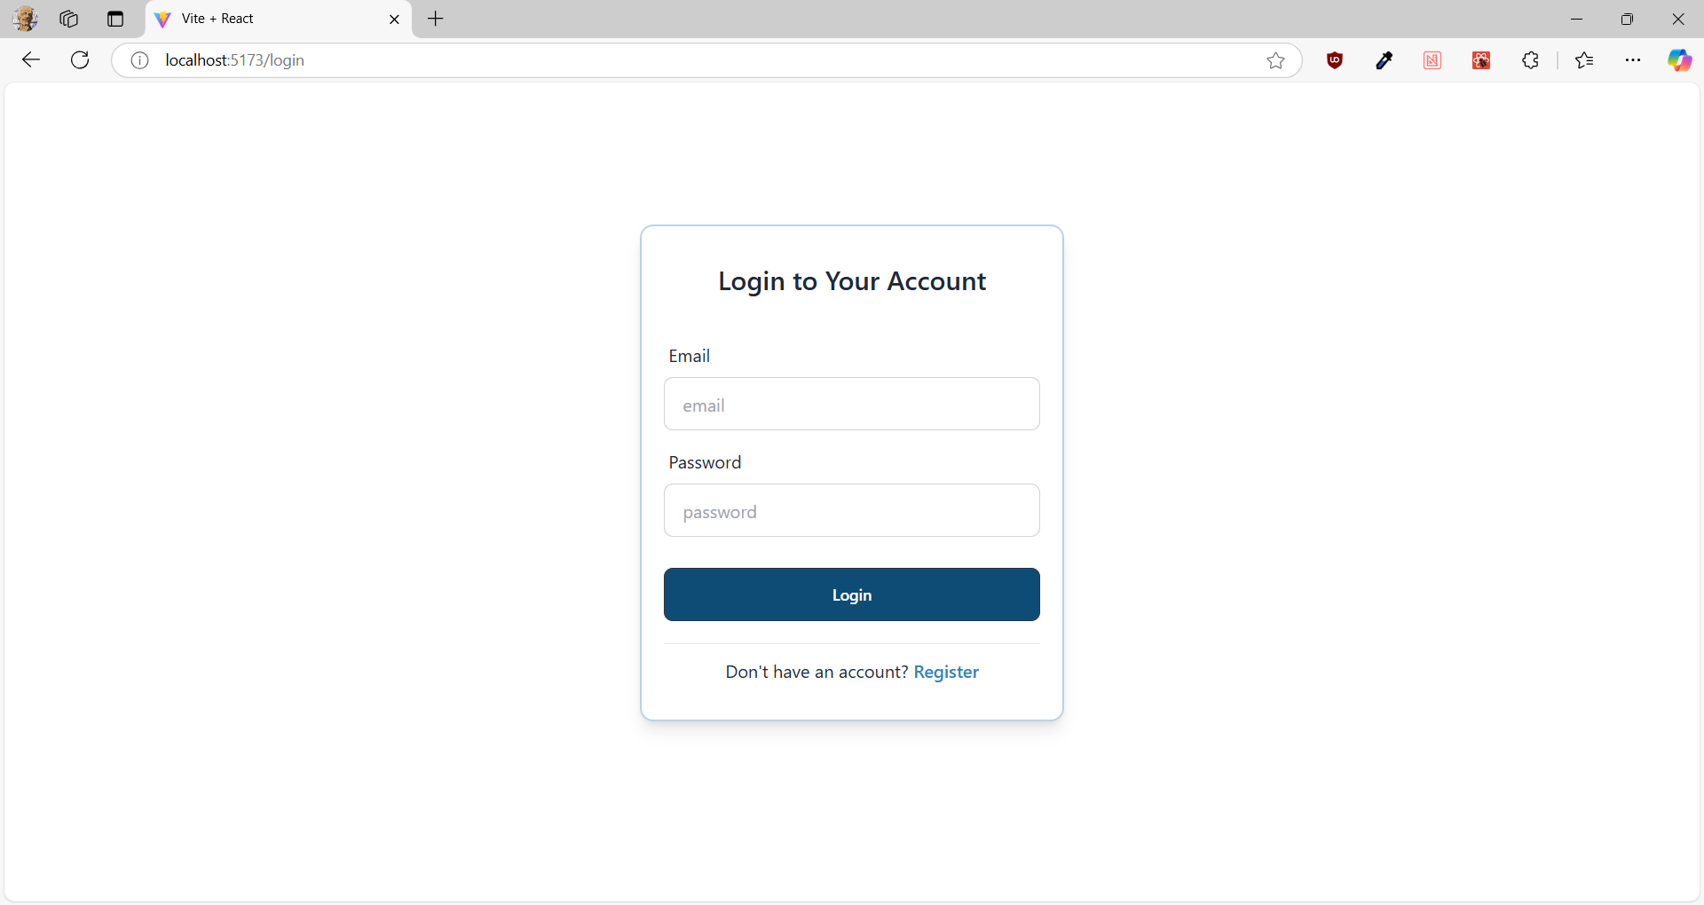
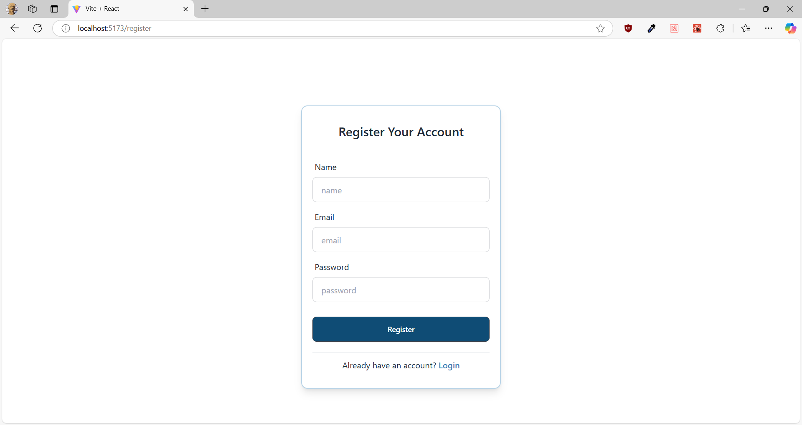
Demonstration
Login
Registration

Slide 4
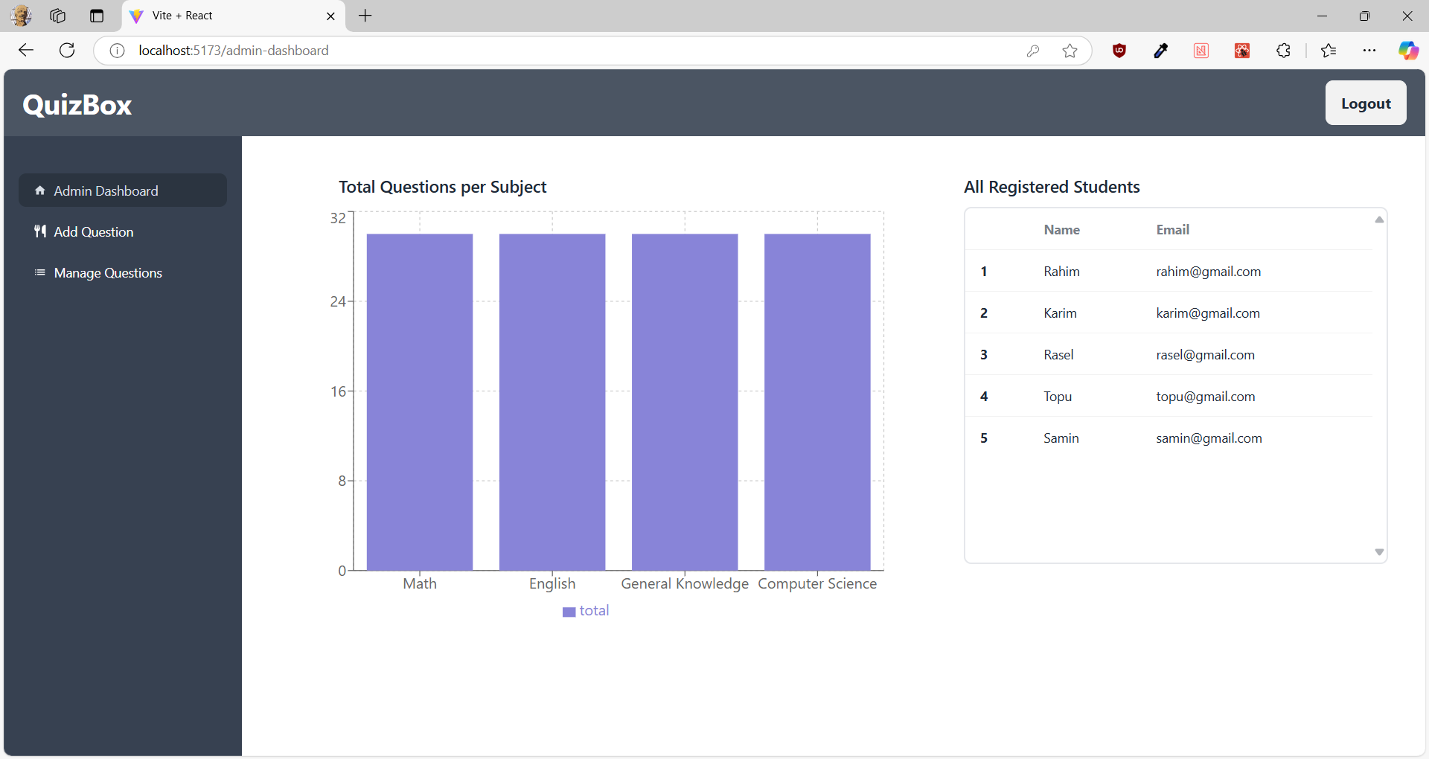
Demonstration

Slide 5
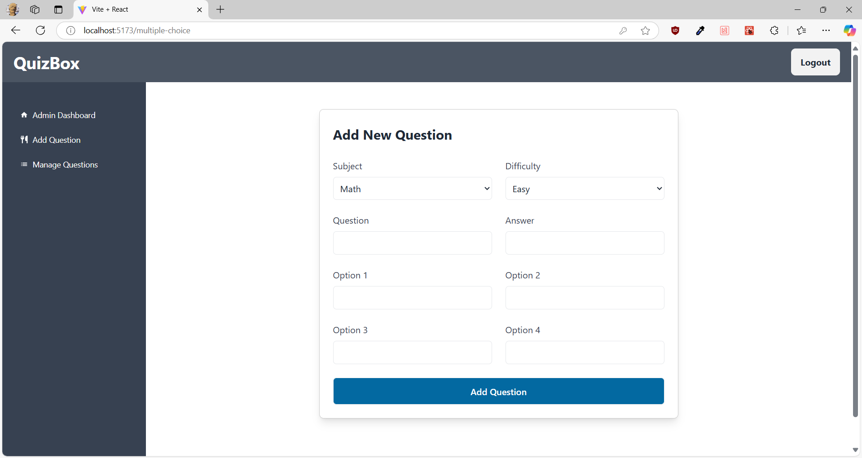
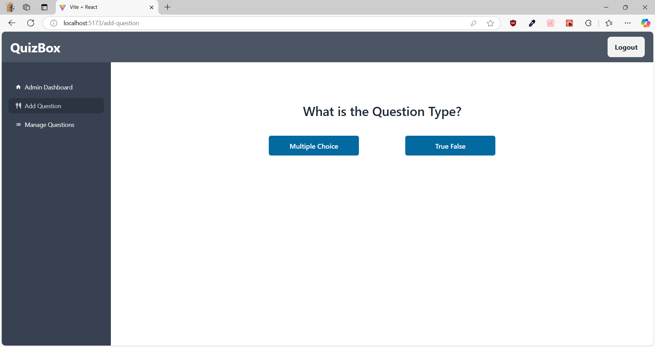
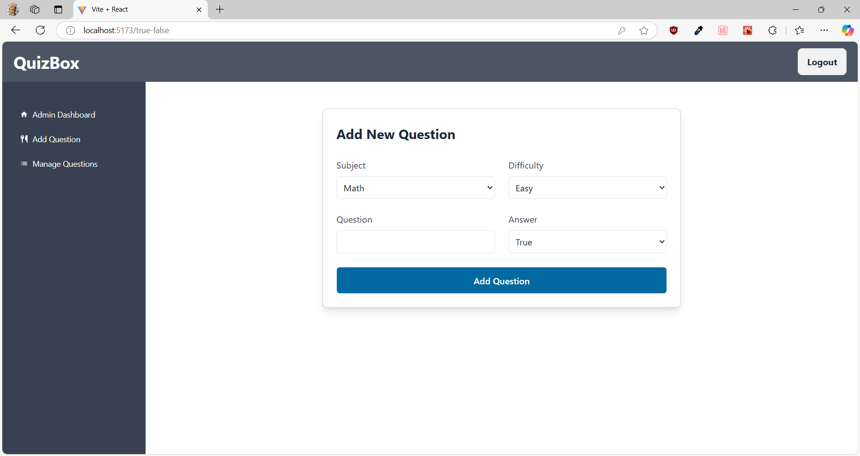
Demonstration

Slide 6
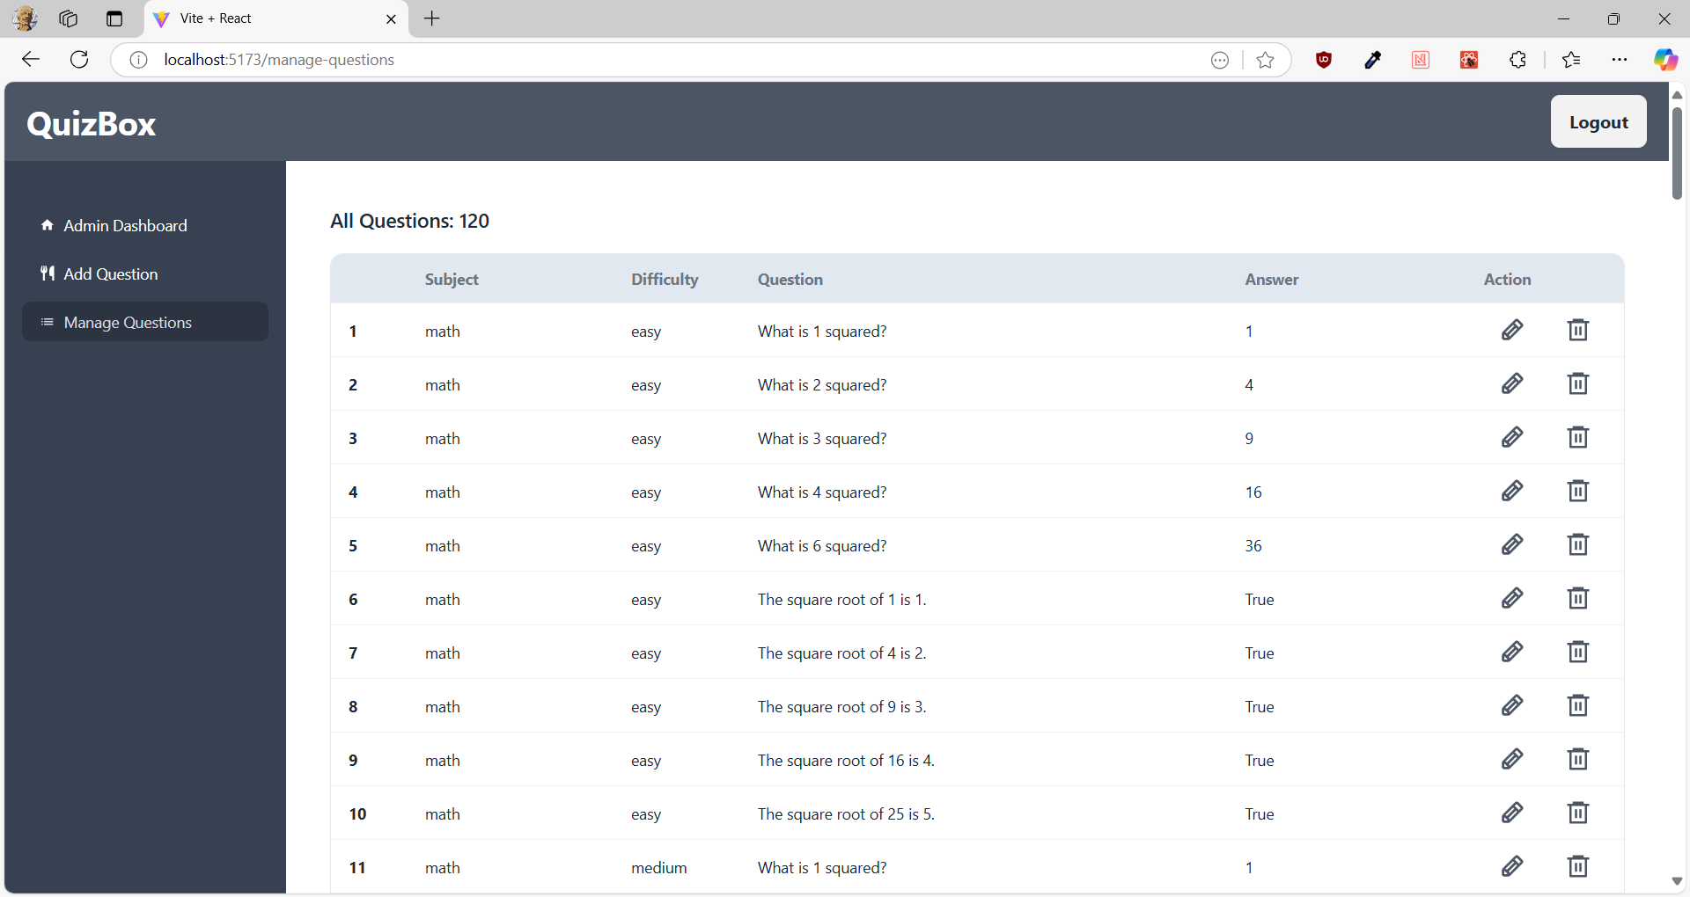
Demonstration

Slide 7

Demonstration

Slide 8
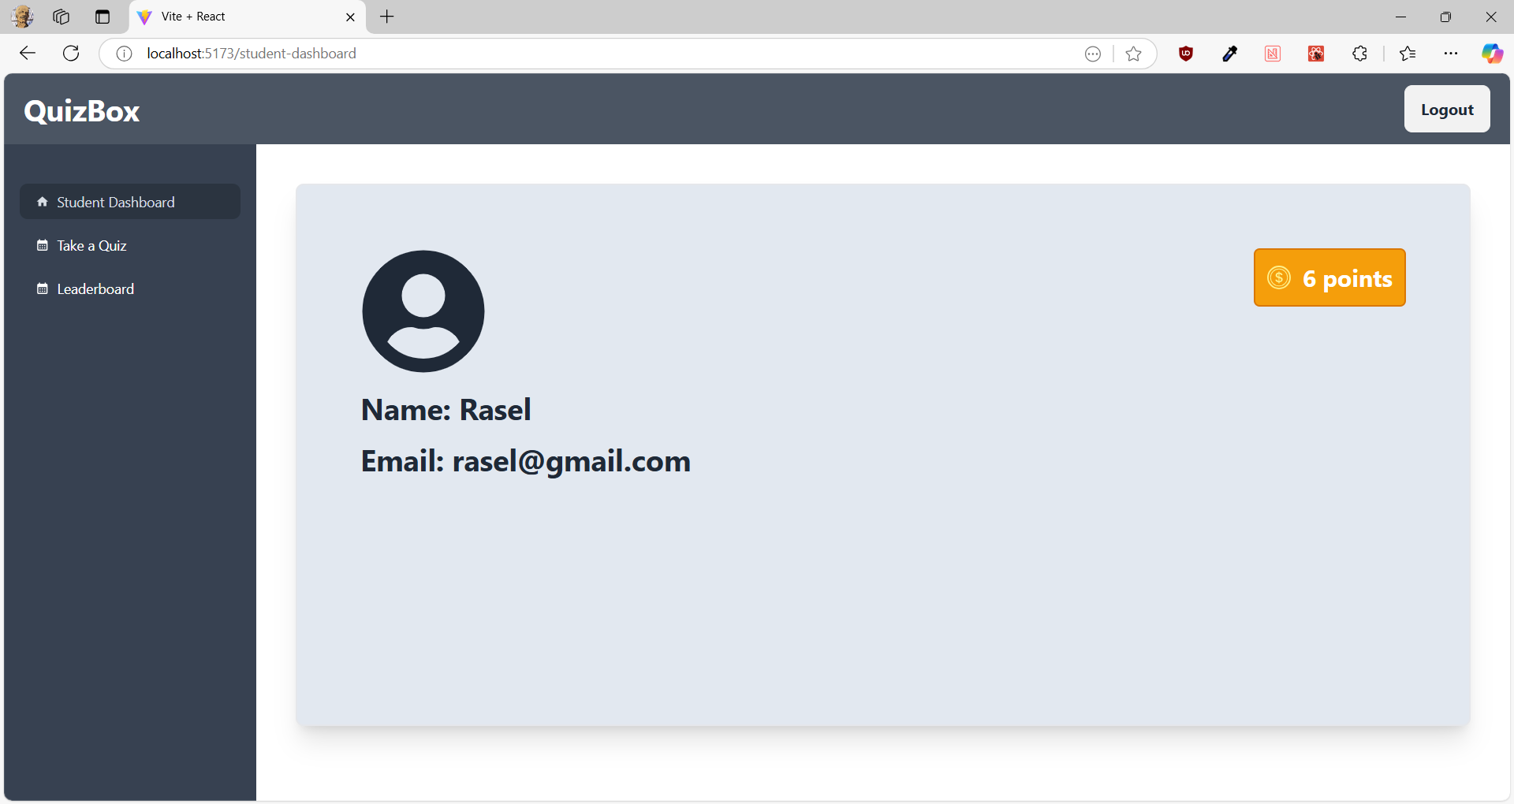
Demonstration

Slide 9
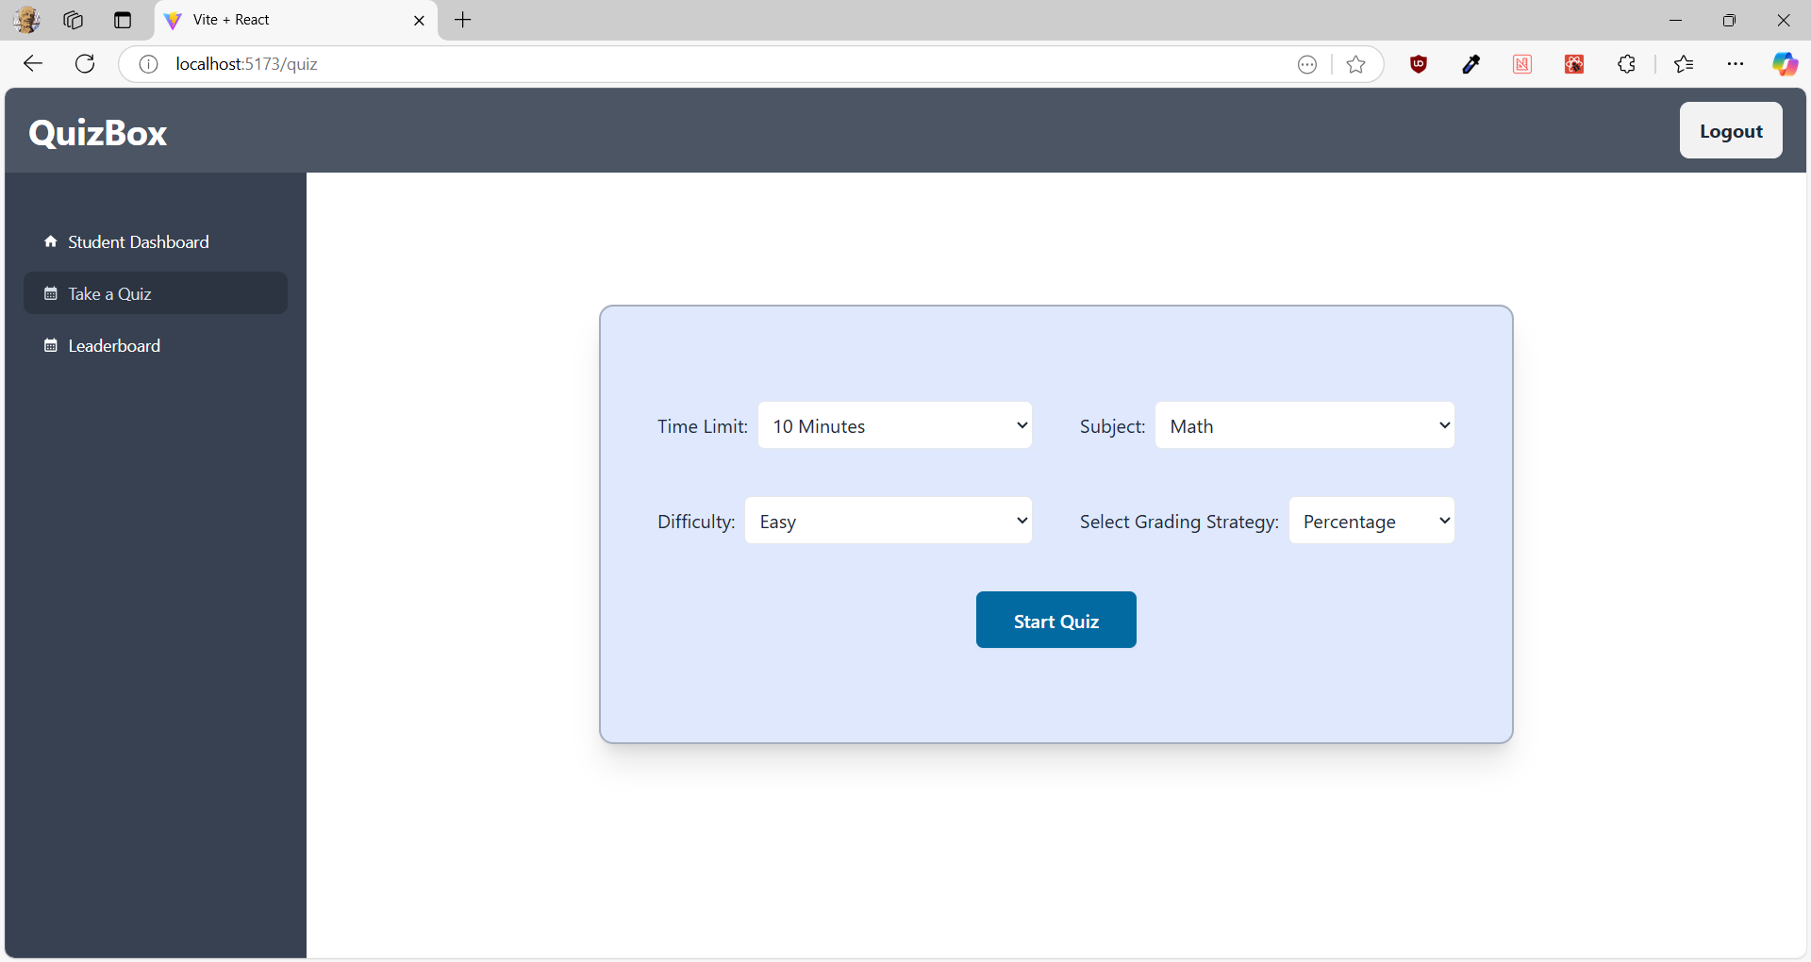
Demonstration
Time Limit:
5 minutes
10 minutes
15 minutes
Subject:
Math
English
Comp. Science
General Knowledge
Difficulty:
Easy
Medium
Hard

Slide 10
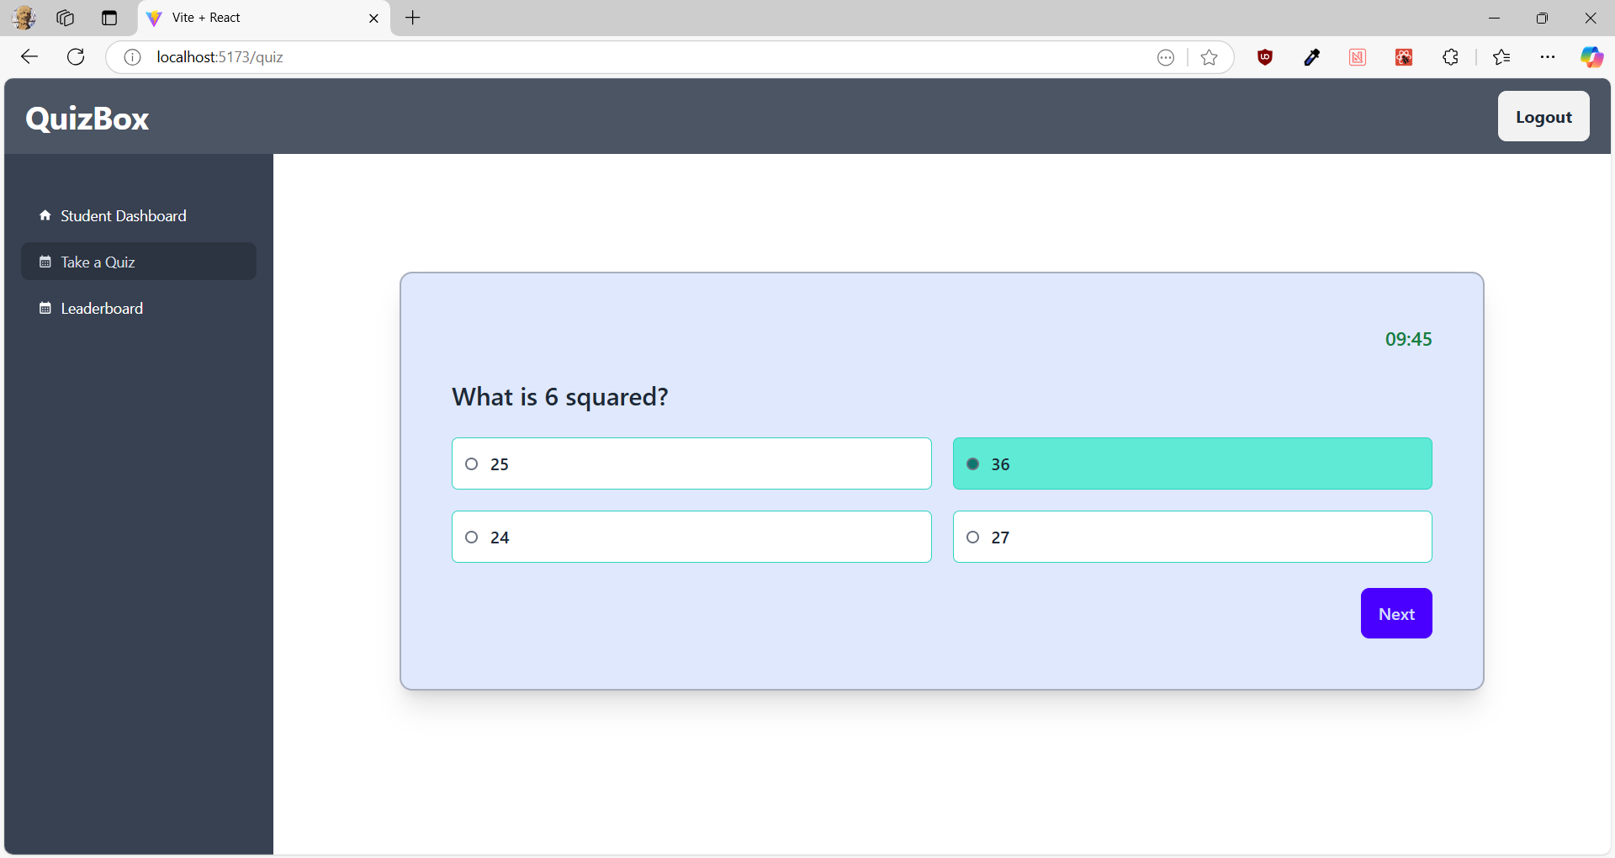
Demonstration

Slide 11
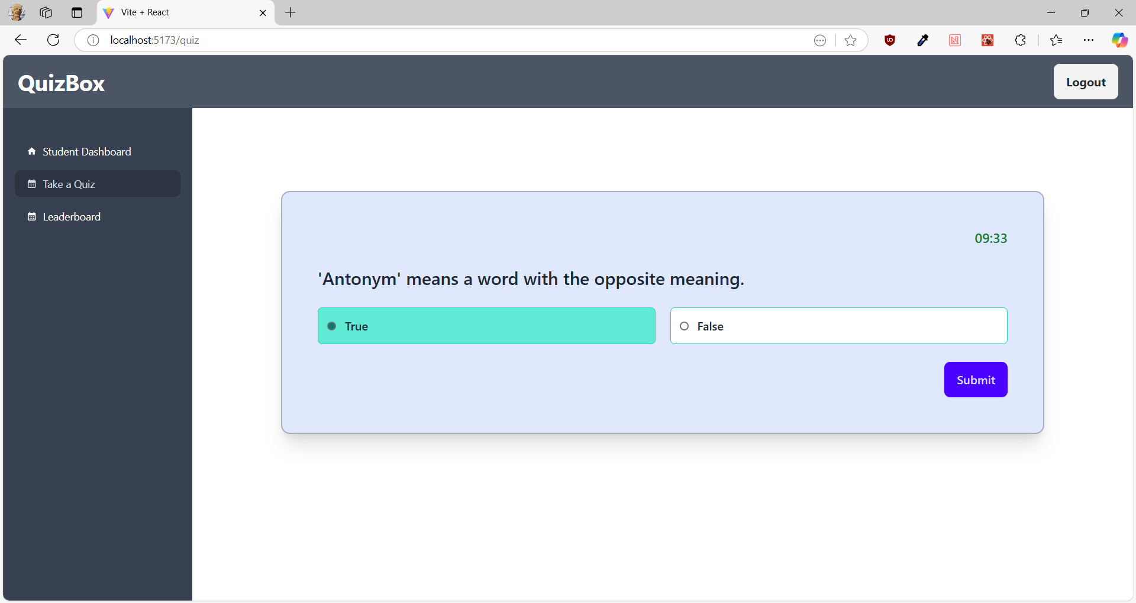
Demonstration

Slide 12
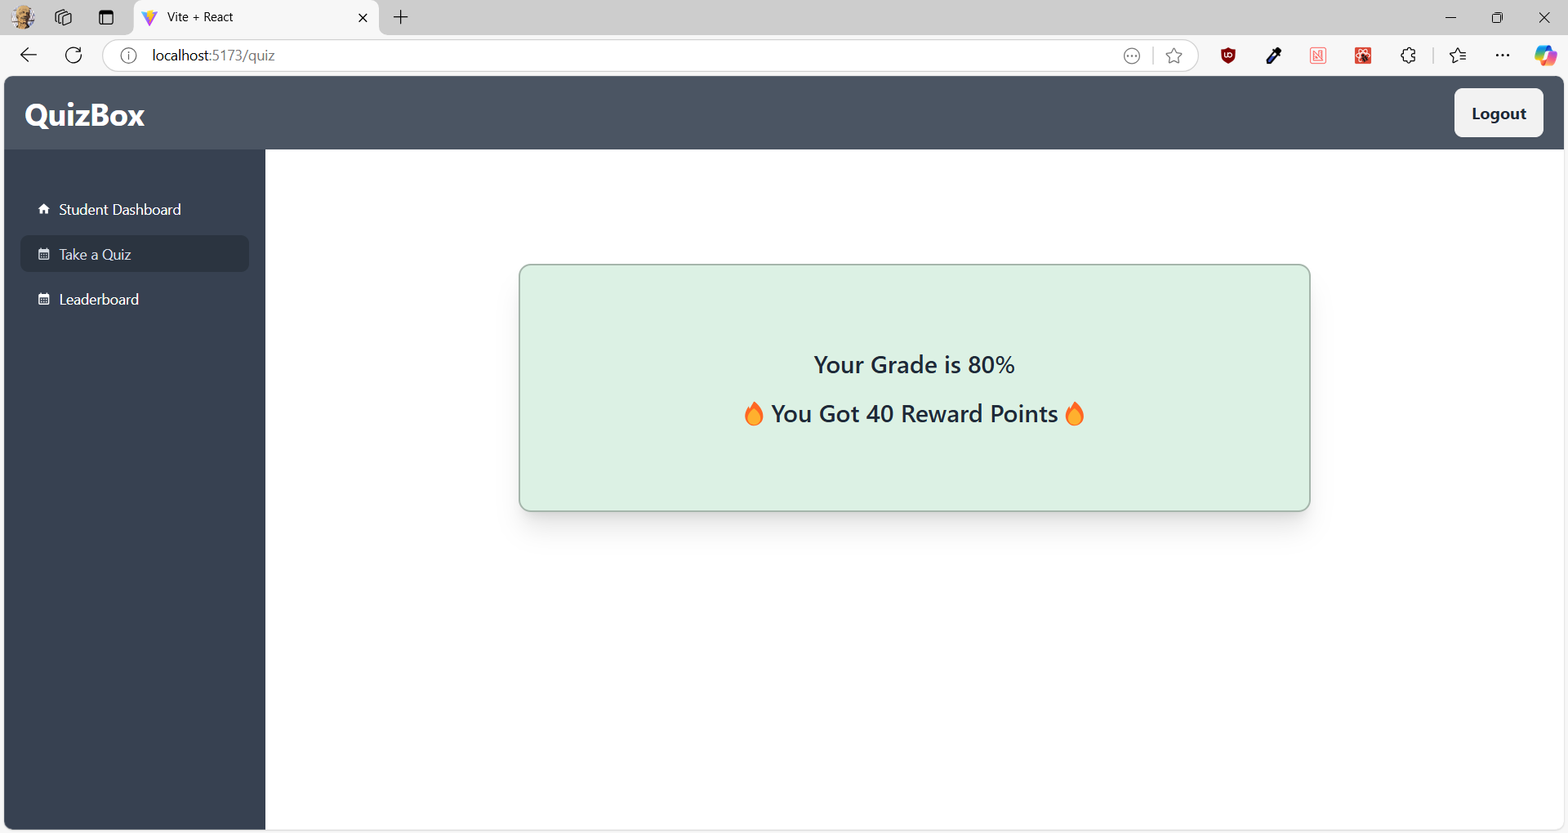
Demonstration

Slide 13
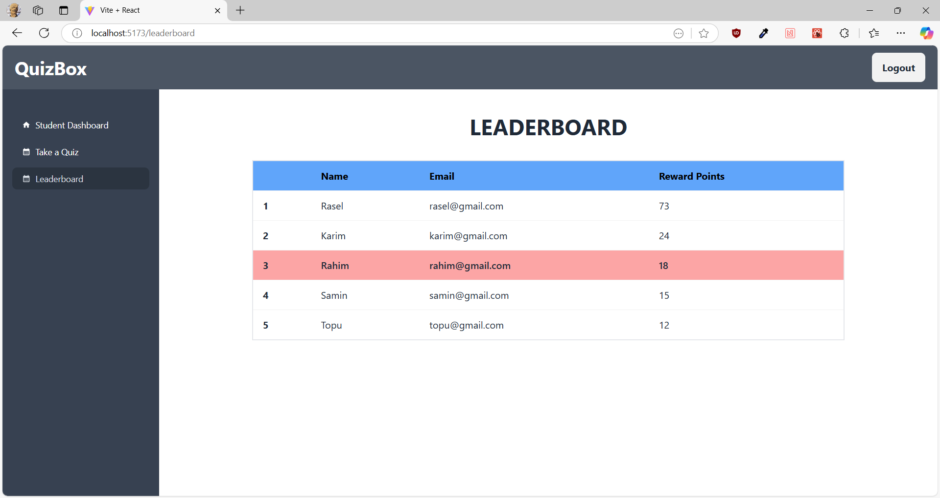
Demonstration

Slide 14
Design Patterns
Singleton
Decorator
Factory
Observer
Strategy
Proxy

Slide 15
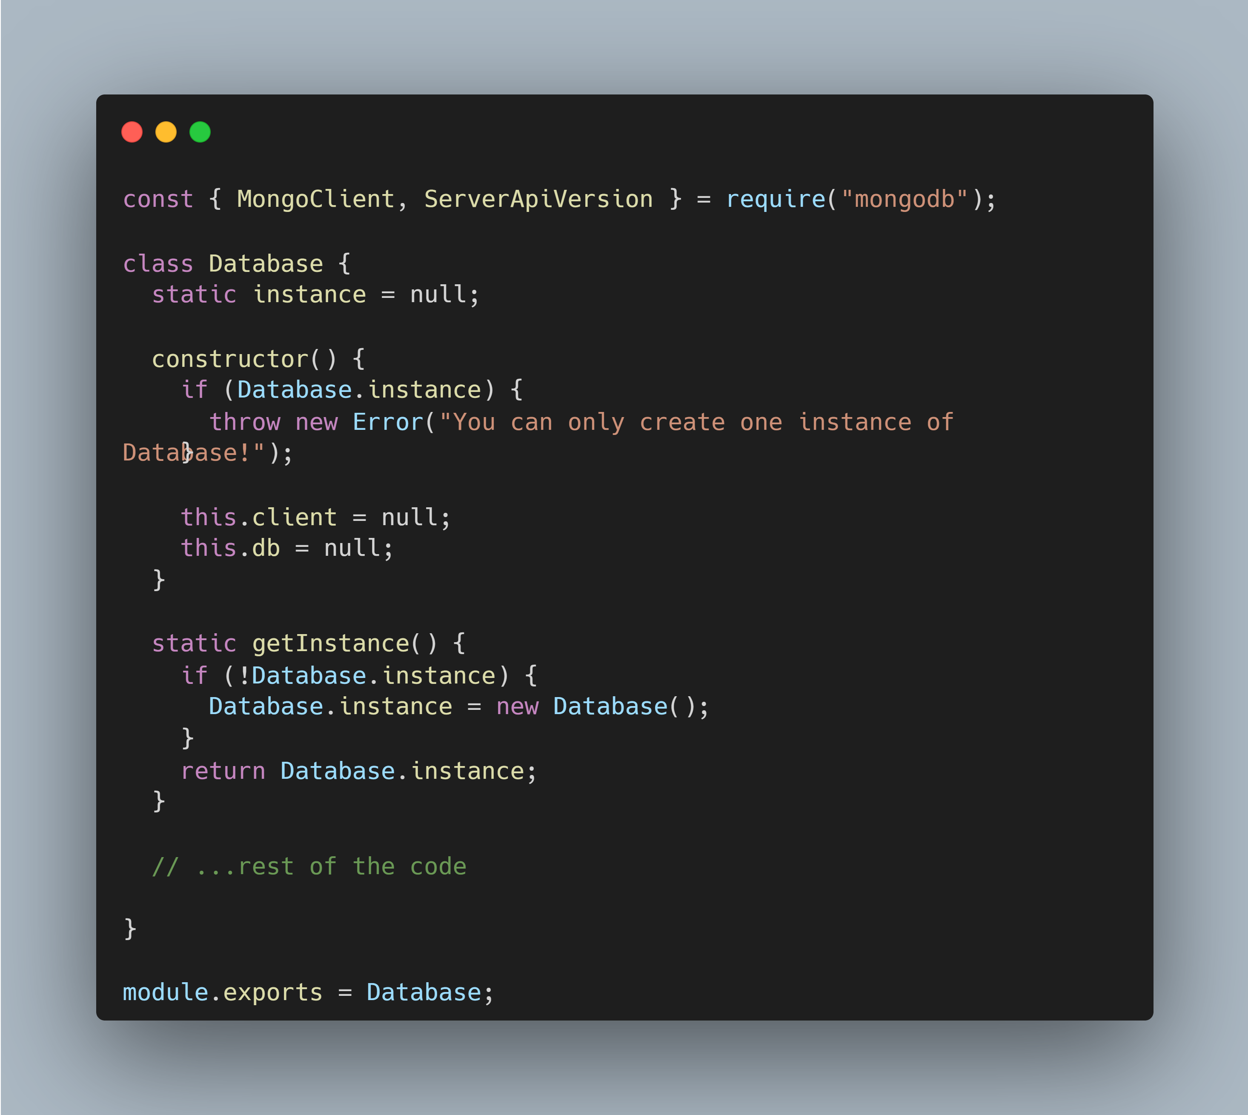
Singleton Design Pattern

Slide 16
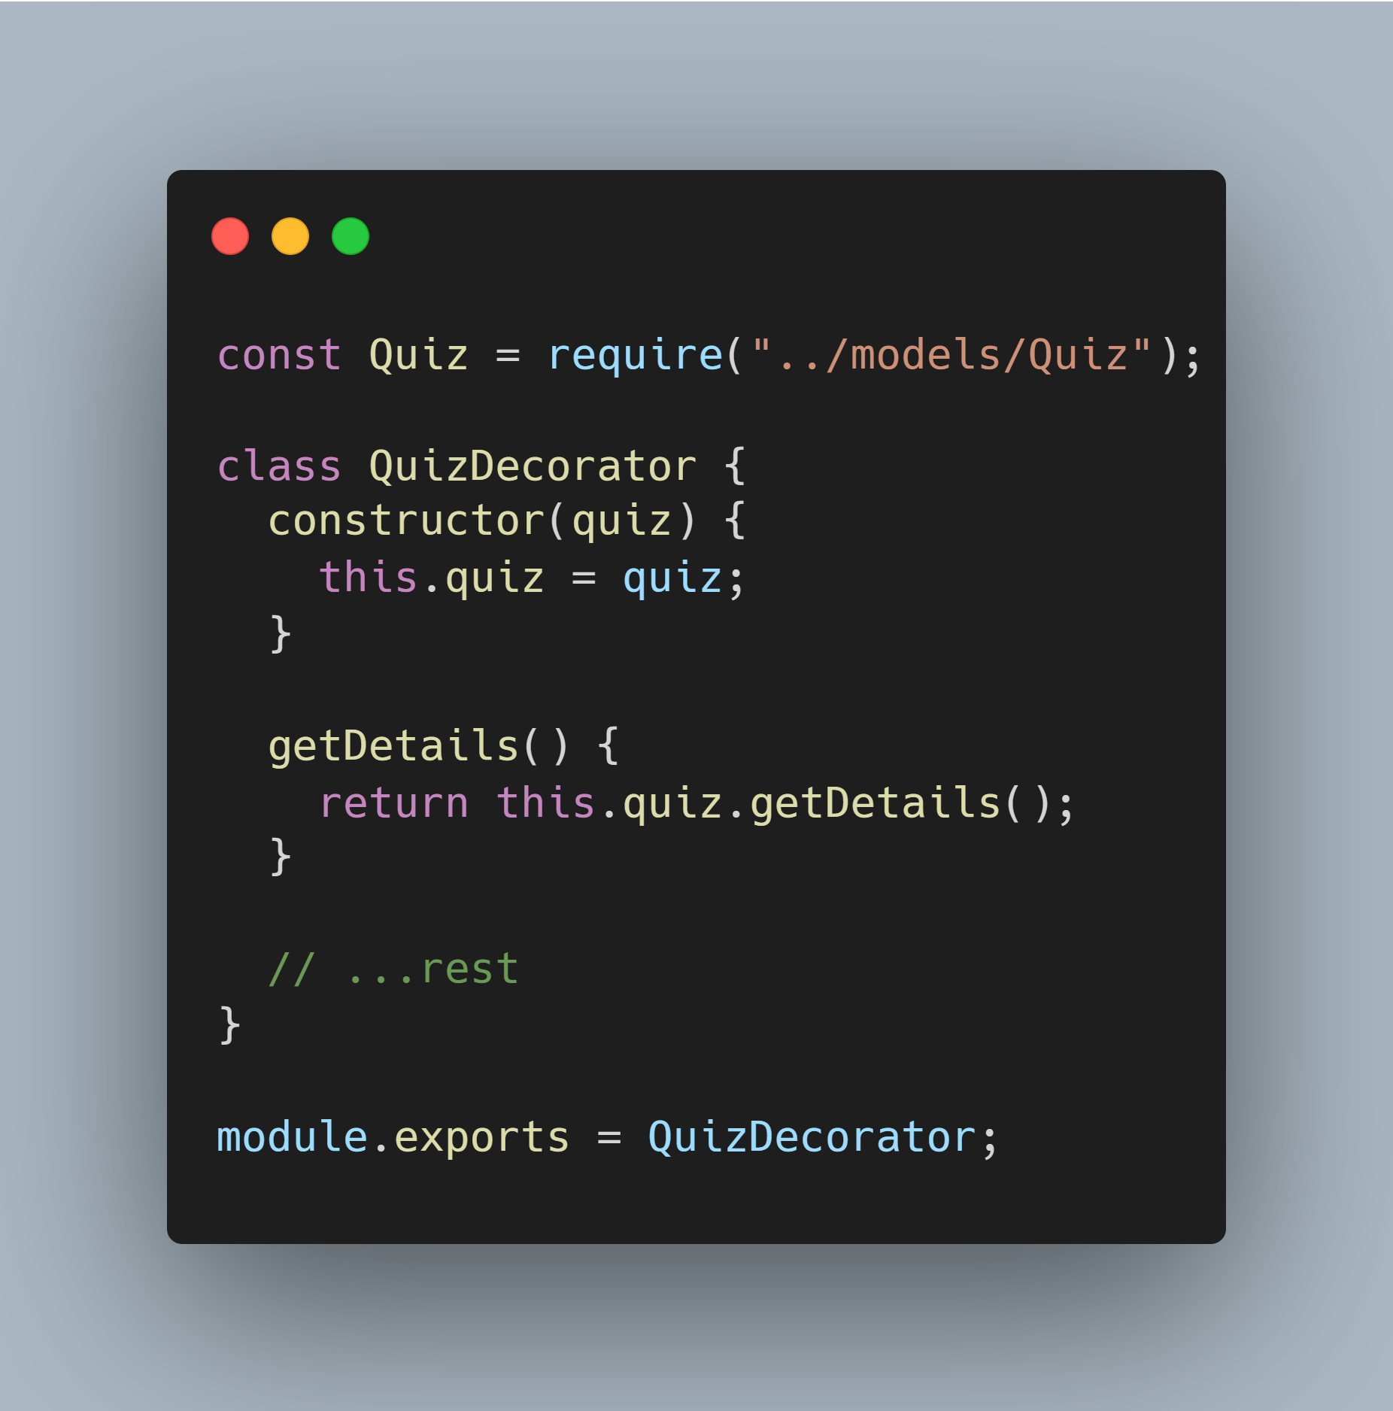
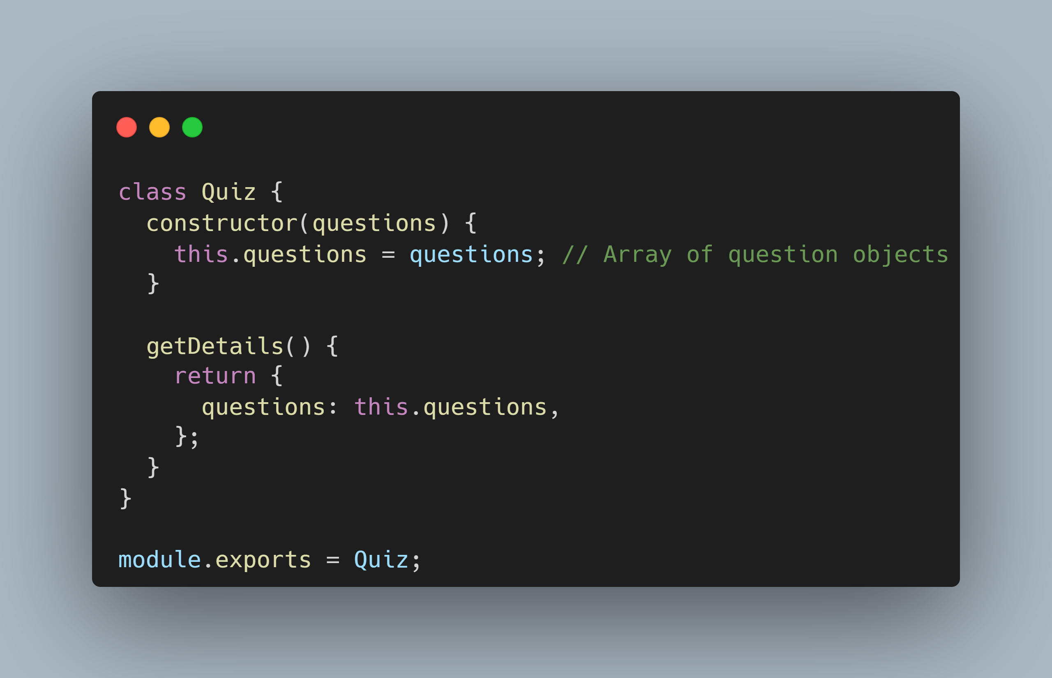
Decorator Design Pattern

Slide 17
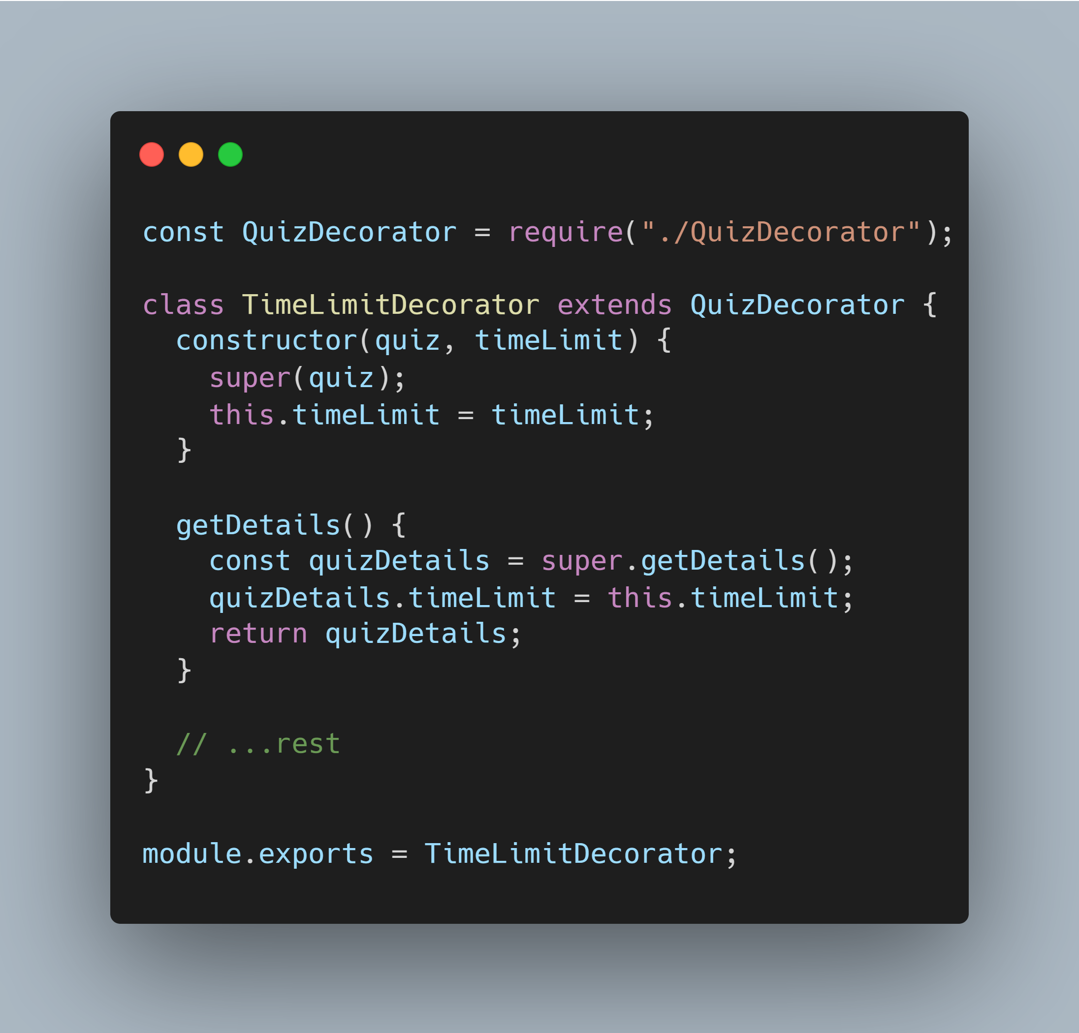
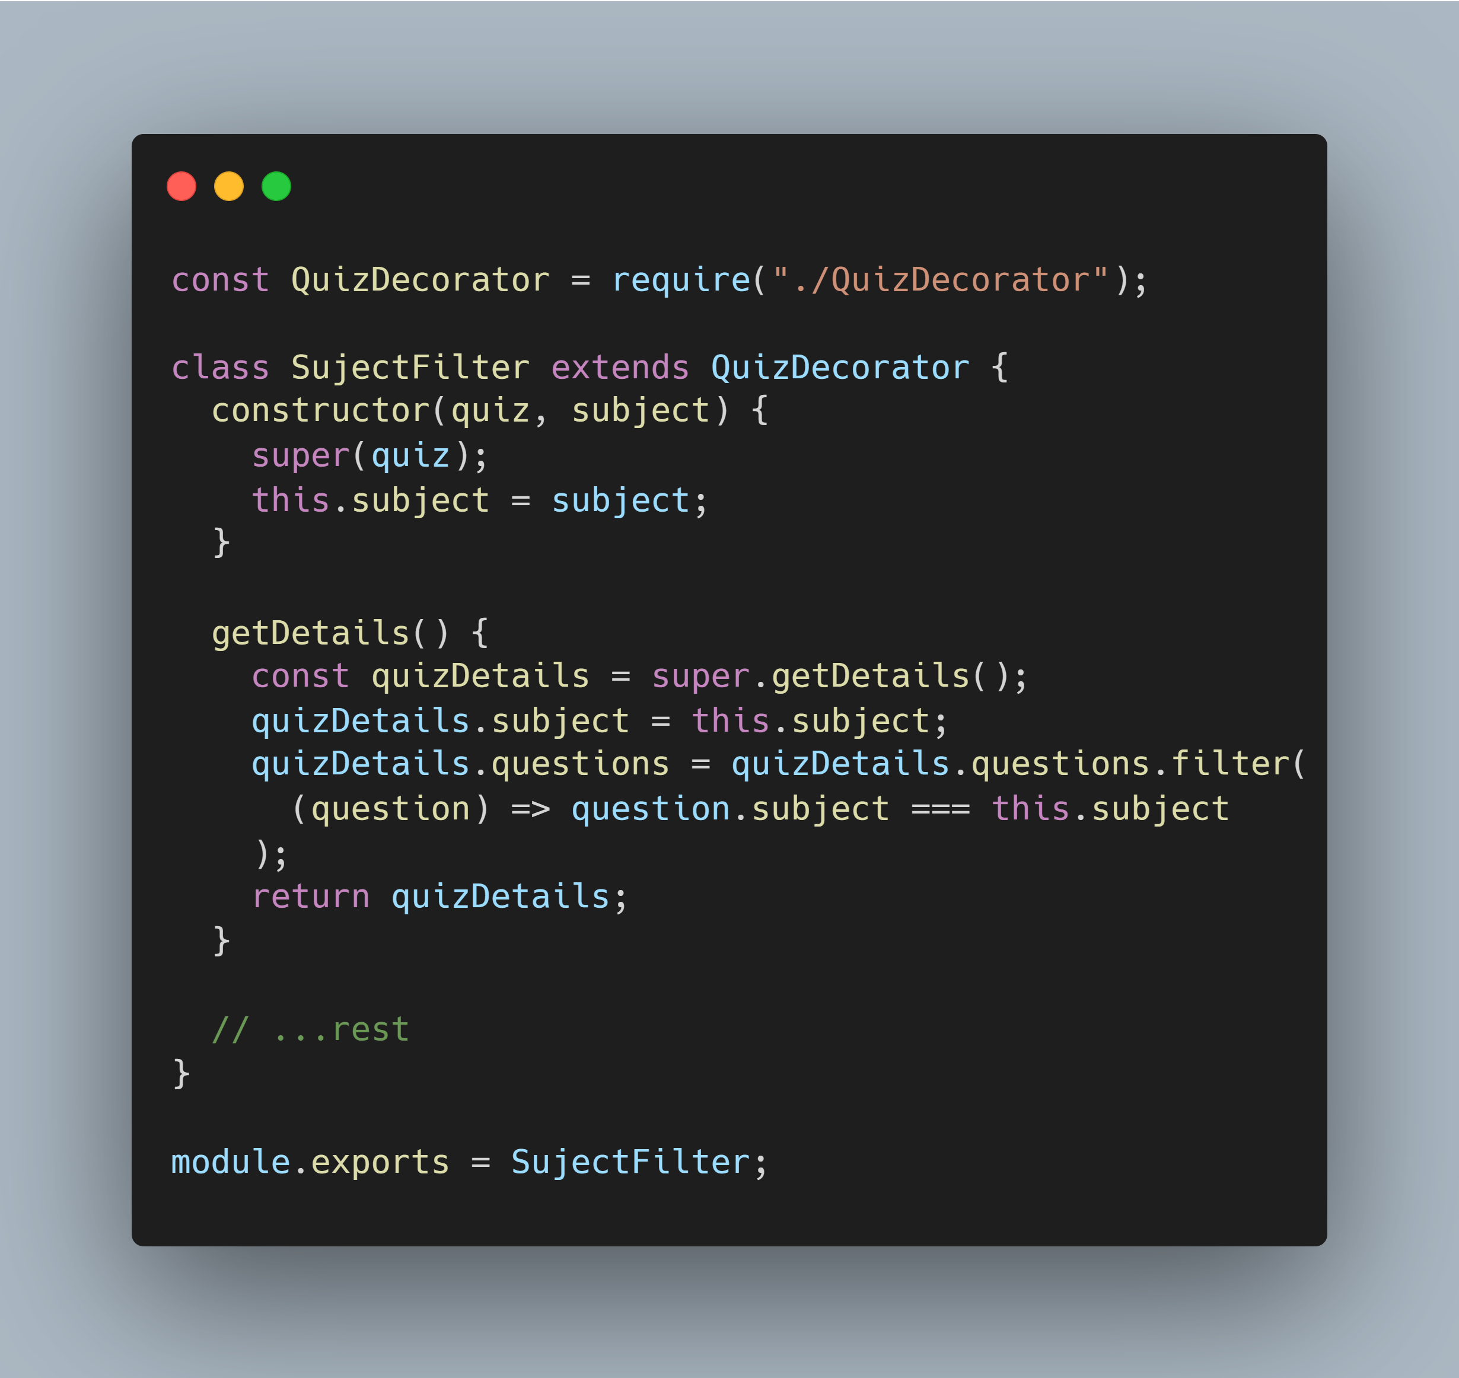
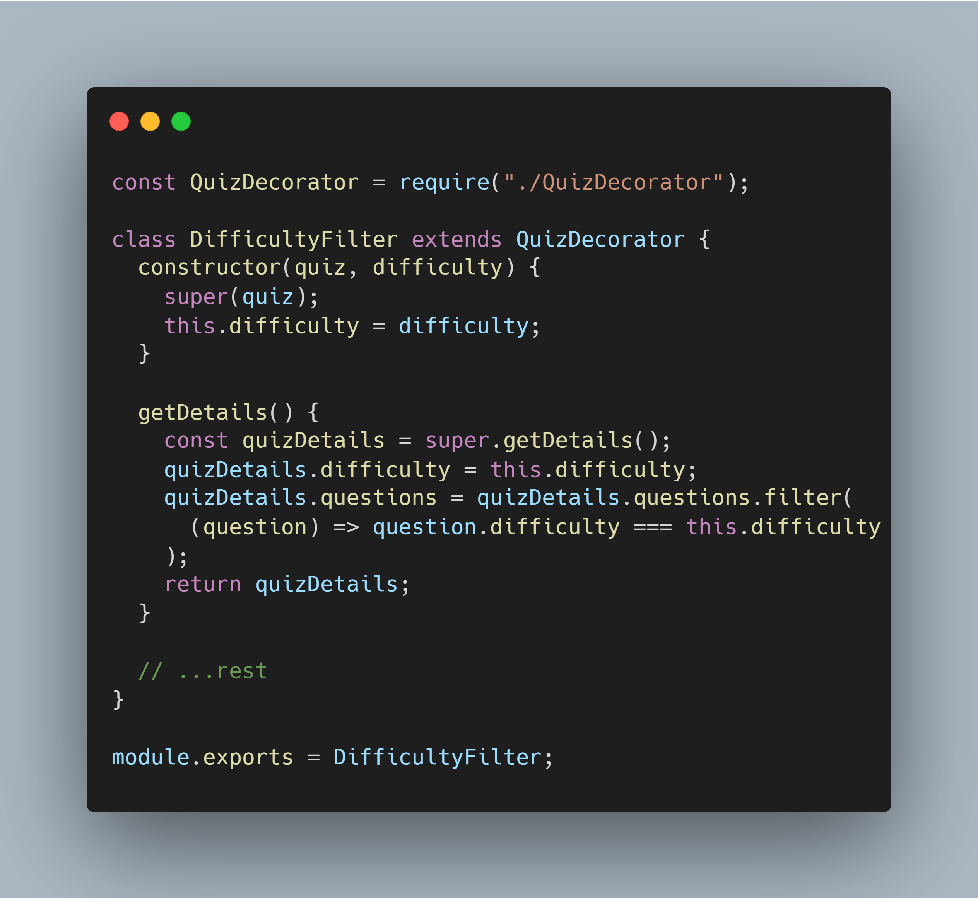
Decorator Design Pattern

Slide 18
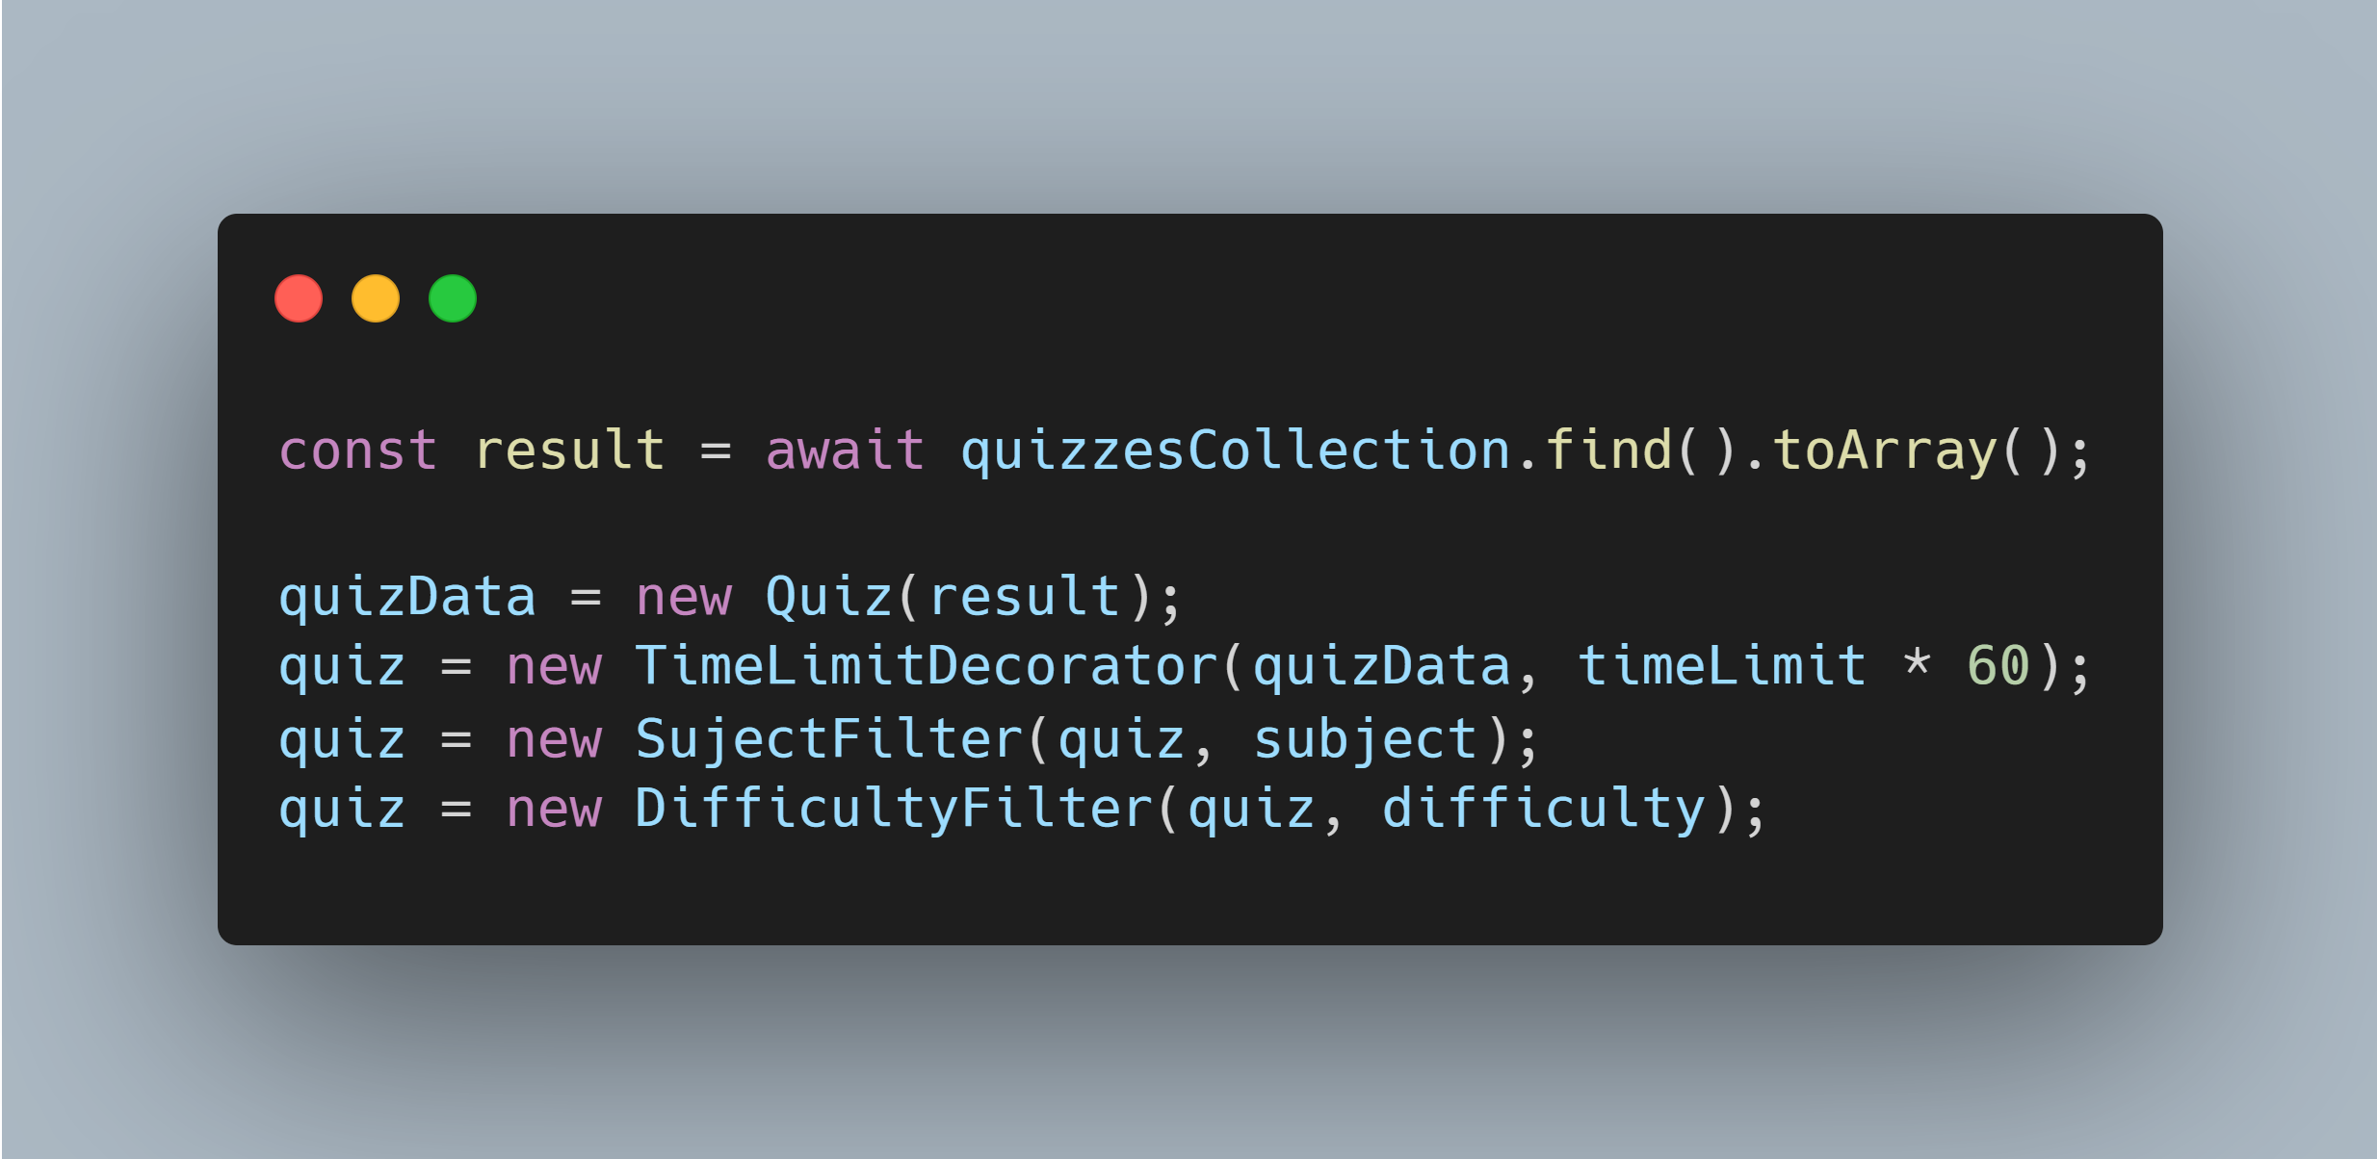
Decorator Design Pattern

Slide 19
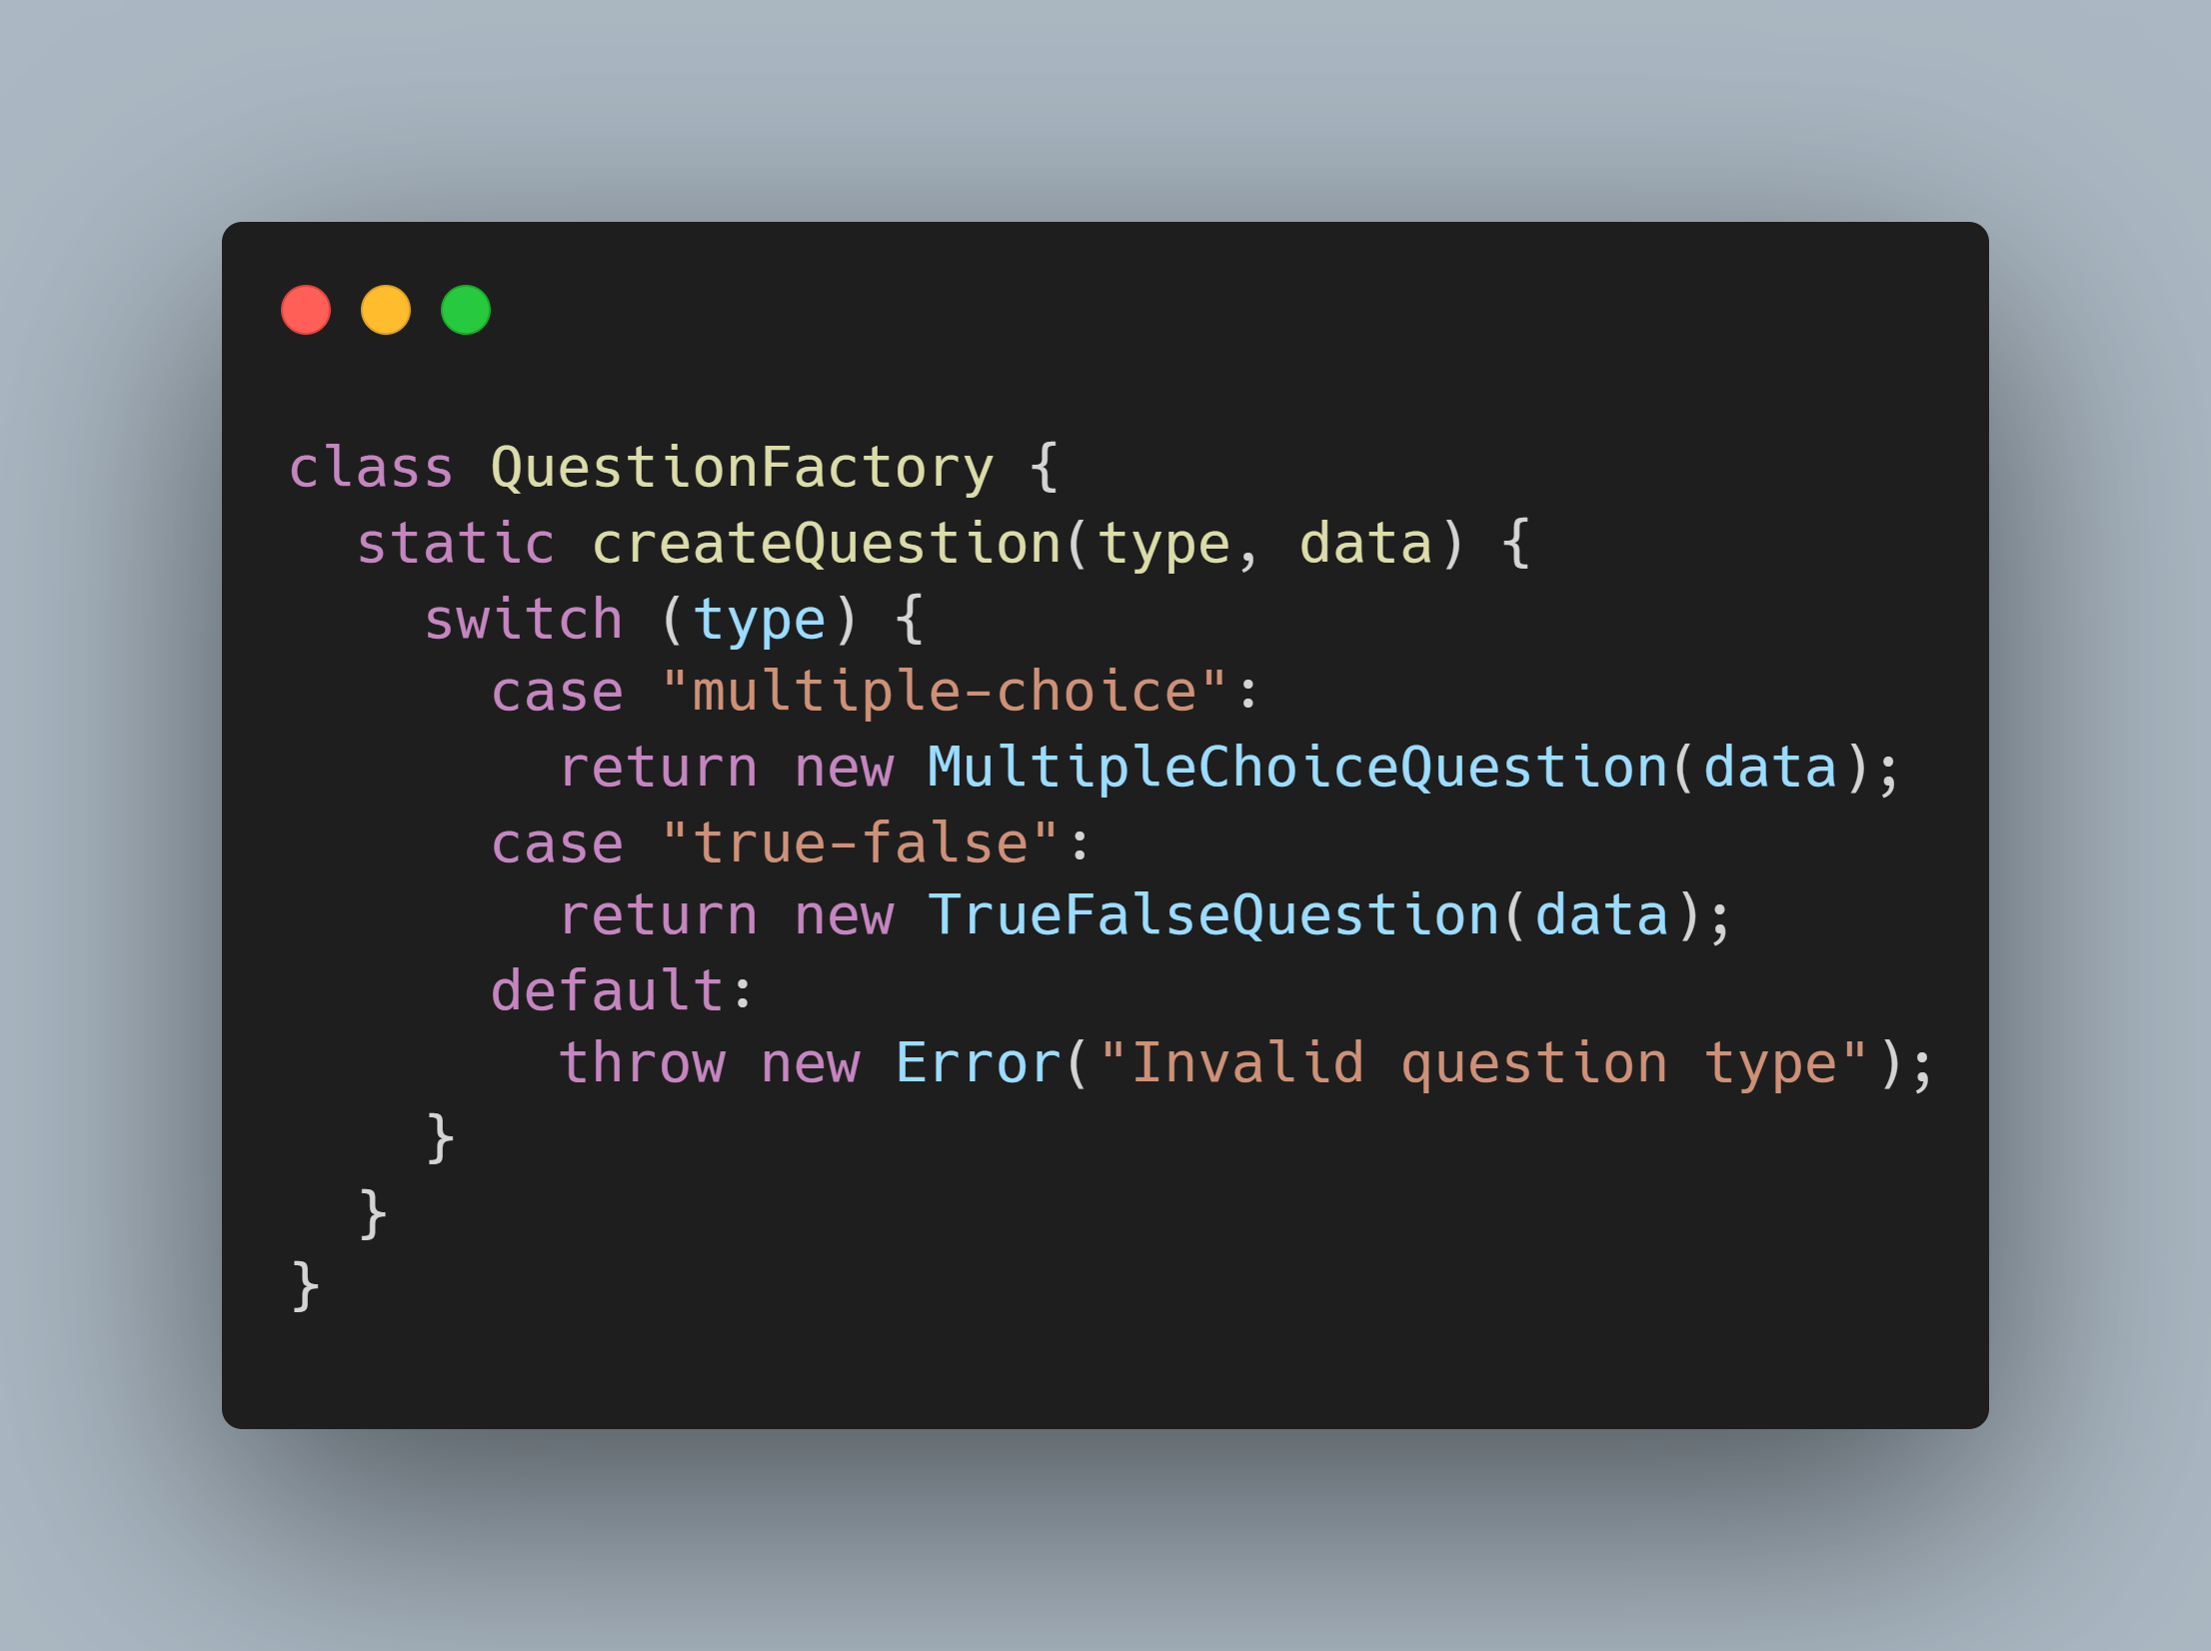
Factory Design Pattern

Slide 20
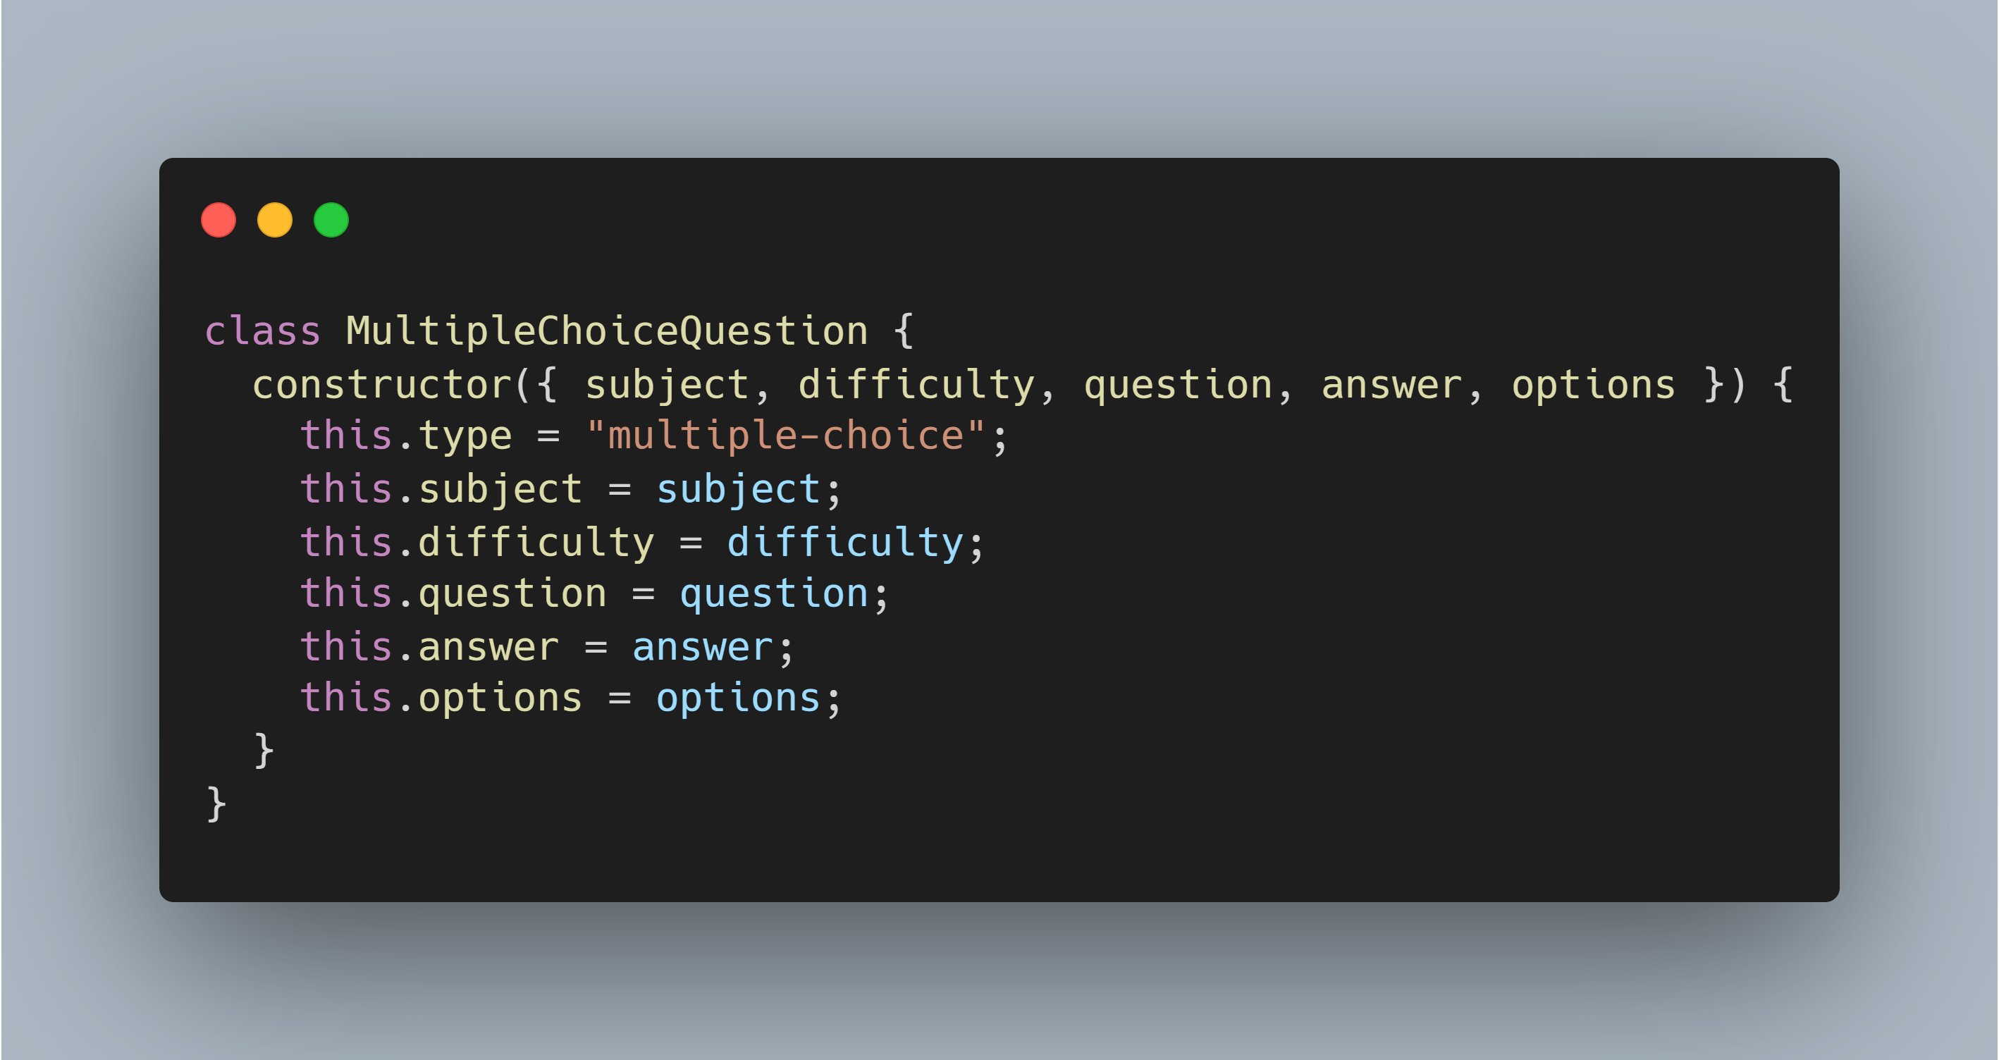
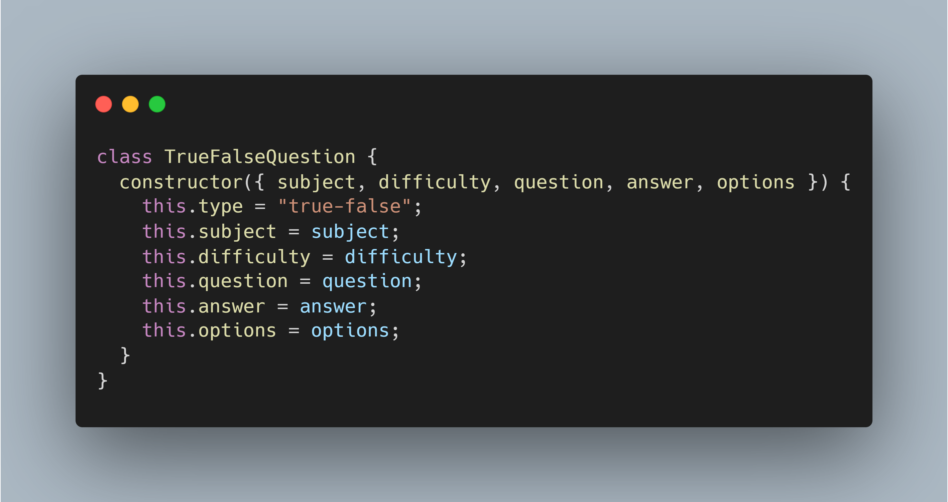
Factory Design Pattern

Slide 21
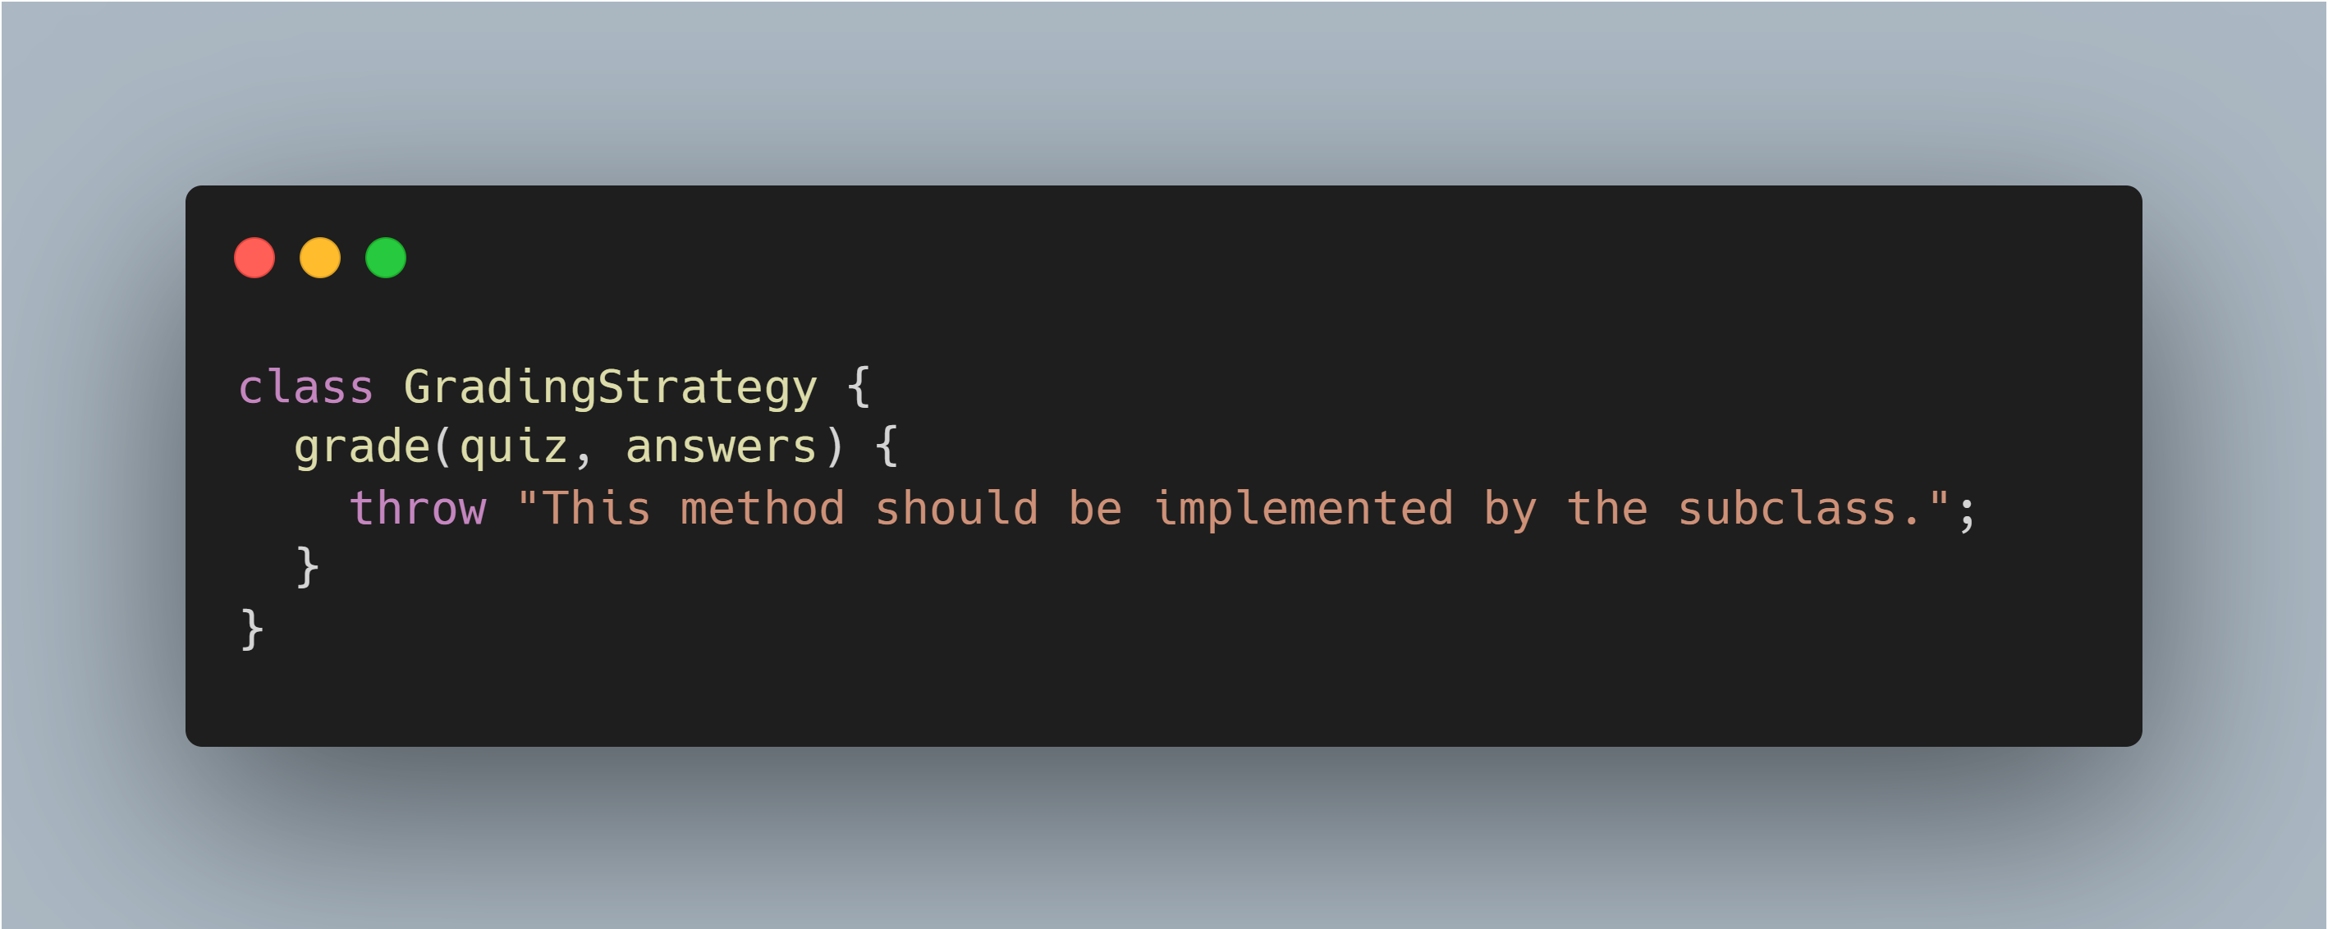
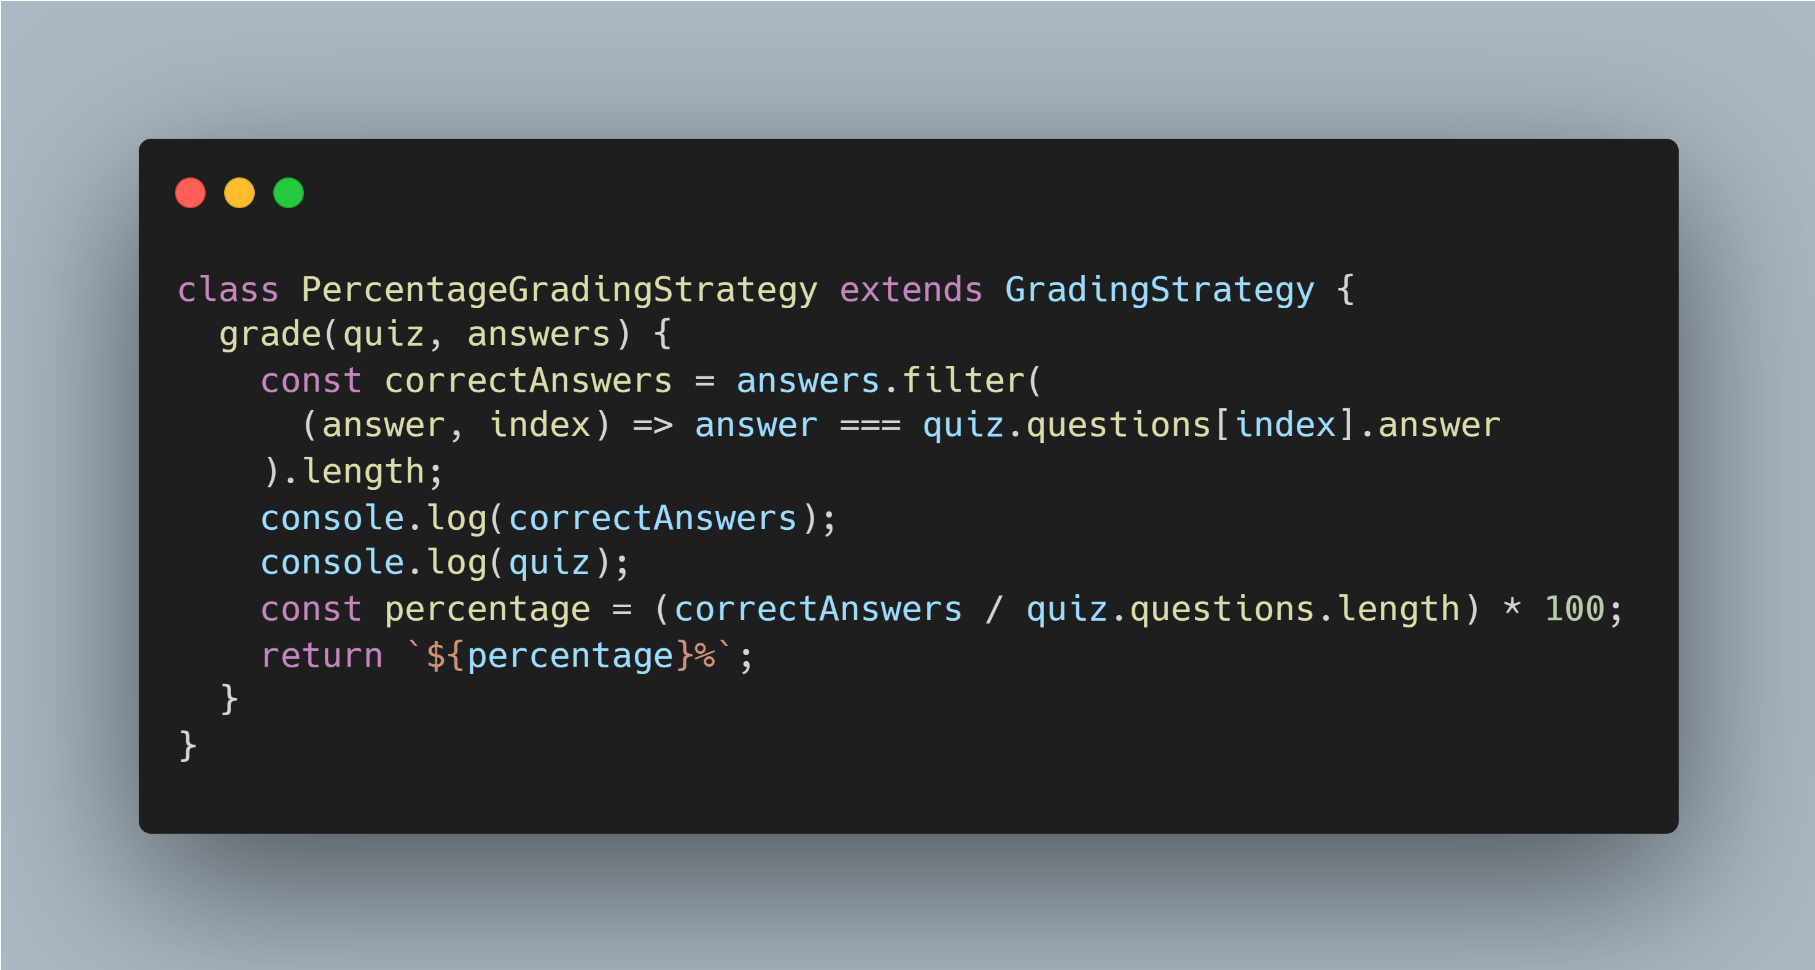
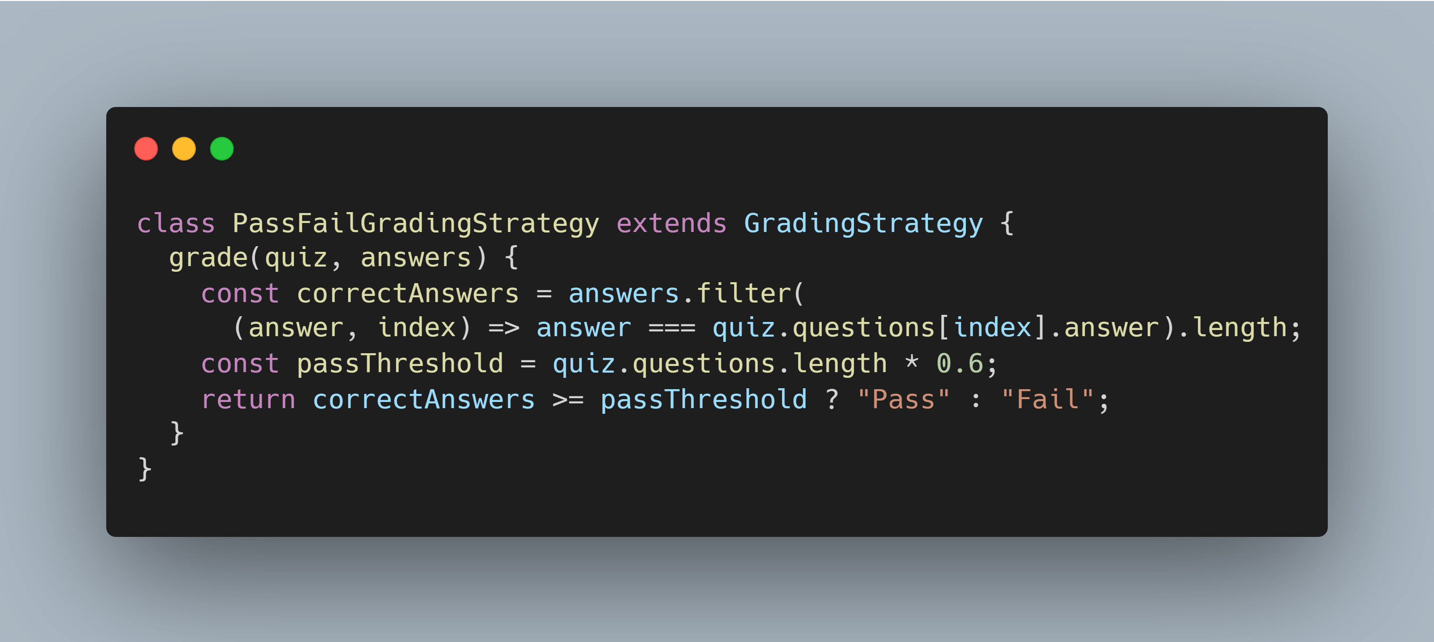
Strategy Design Pattern

Slide 22
Strategy Design Pattern

Slide 23
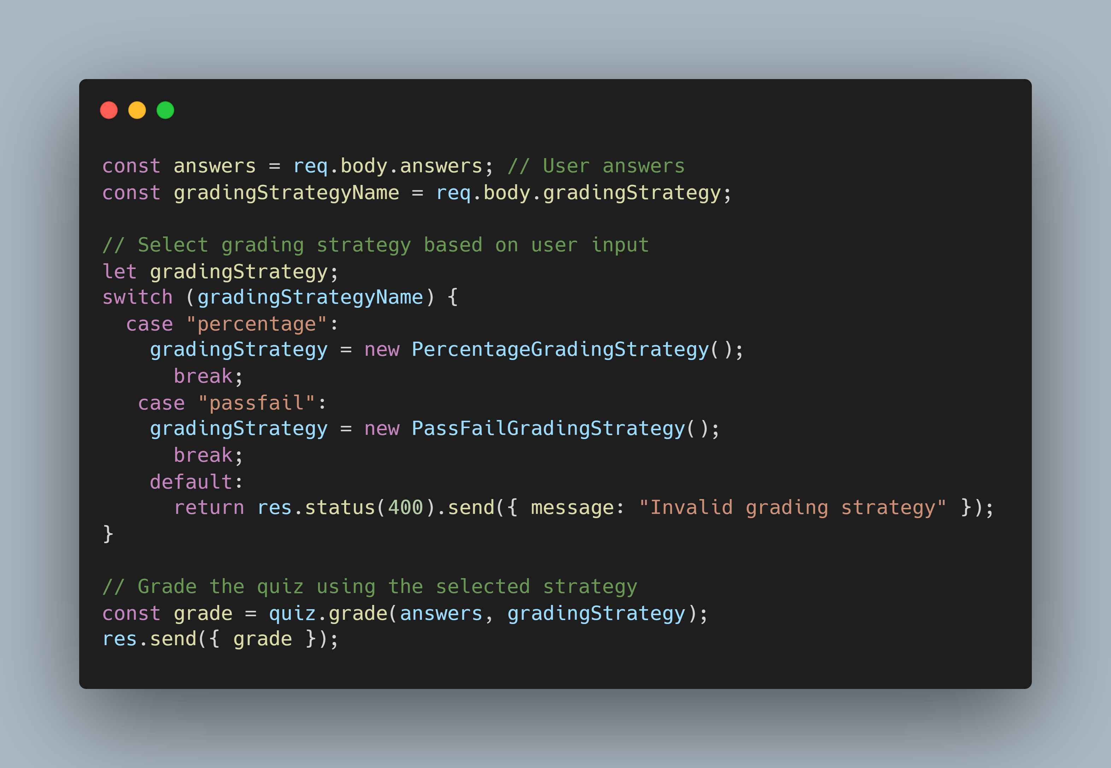
Strategy Design Pattern

Slide 24
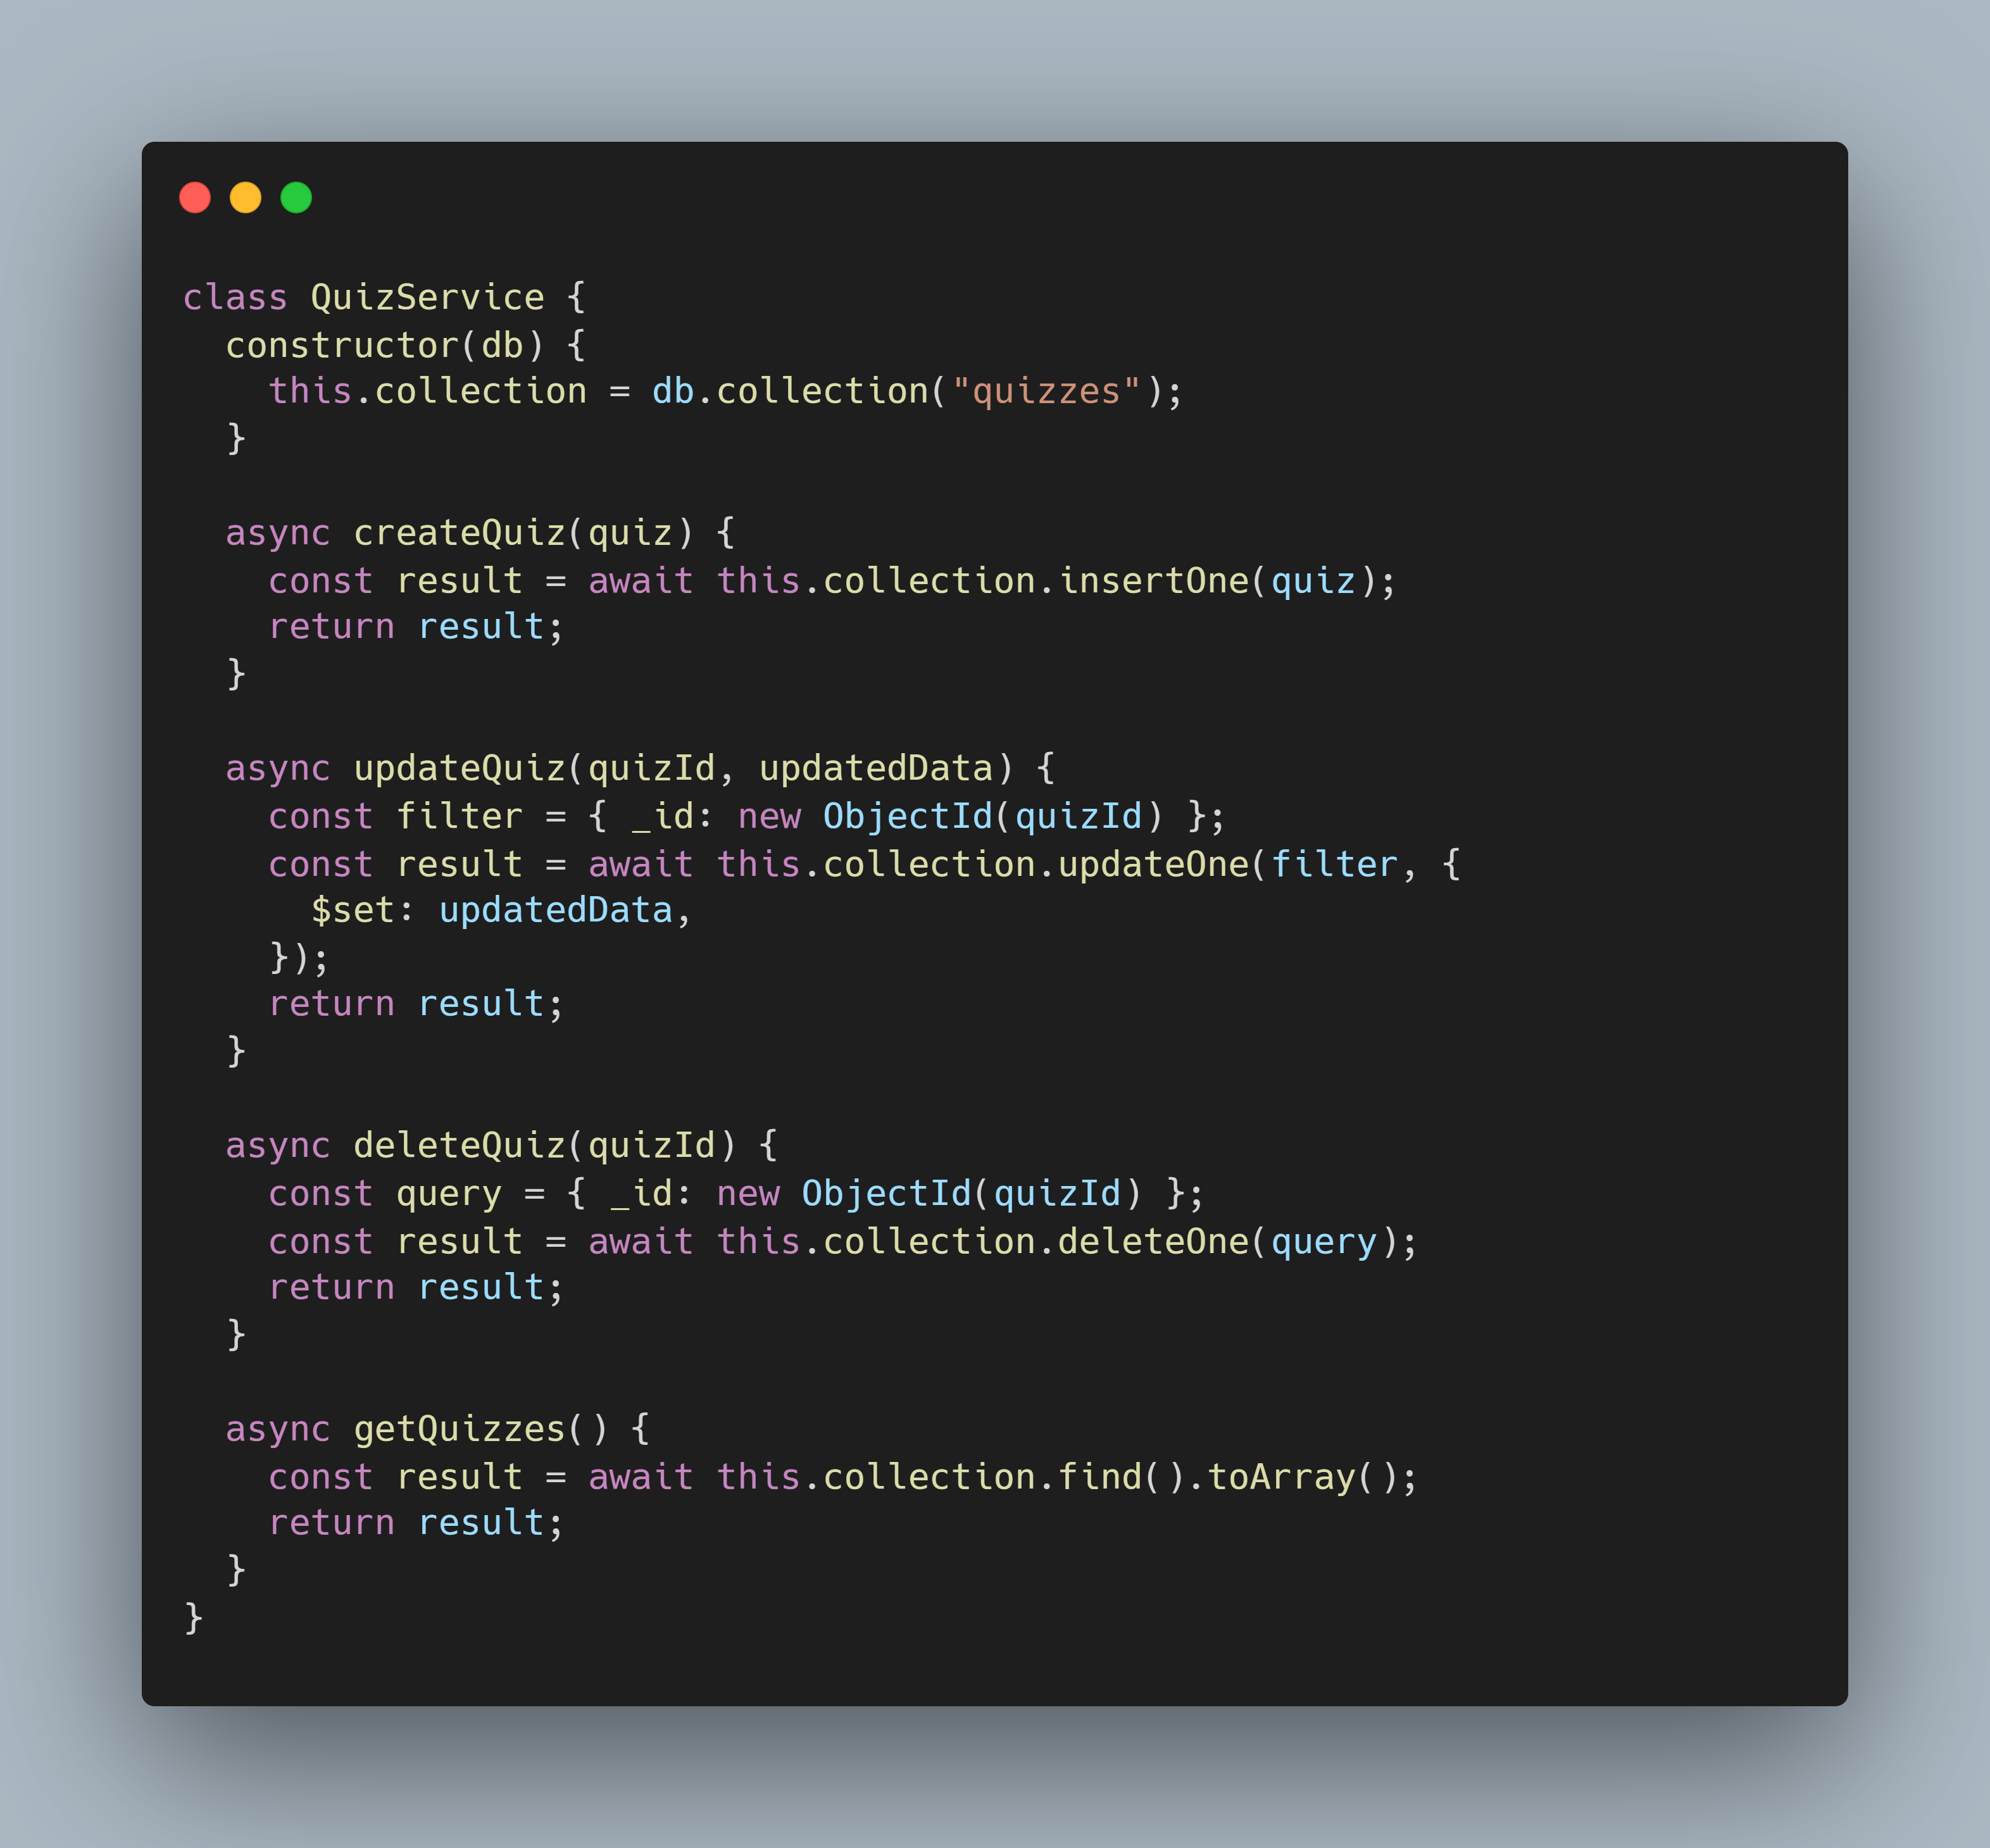
Proxy Design Pattern

Slide 25
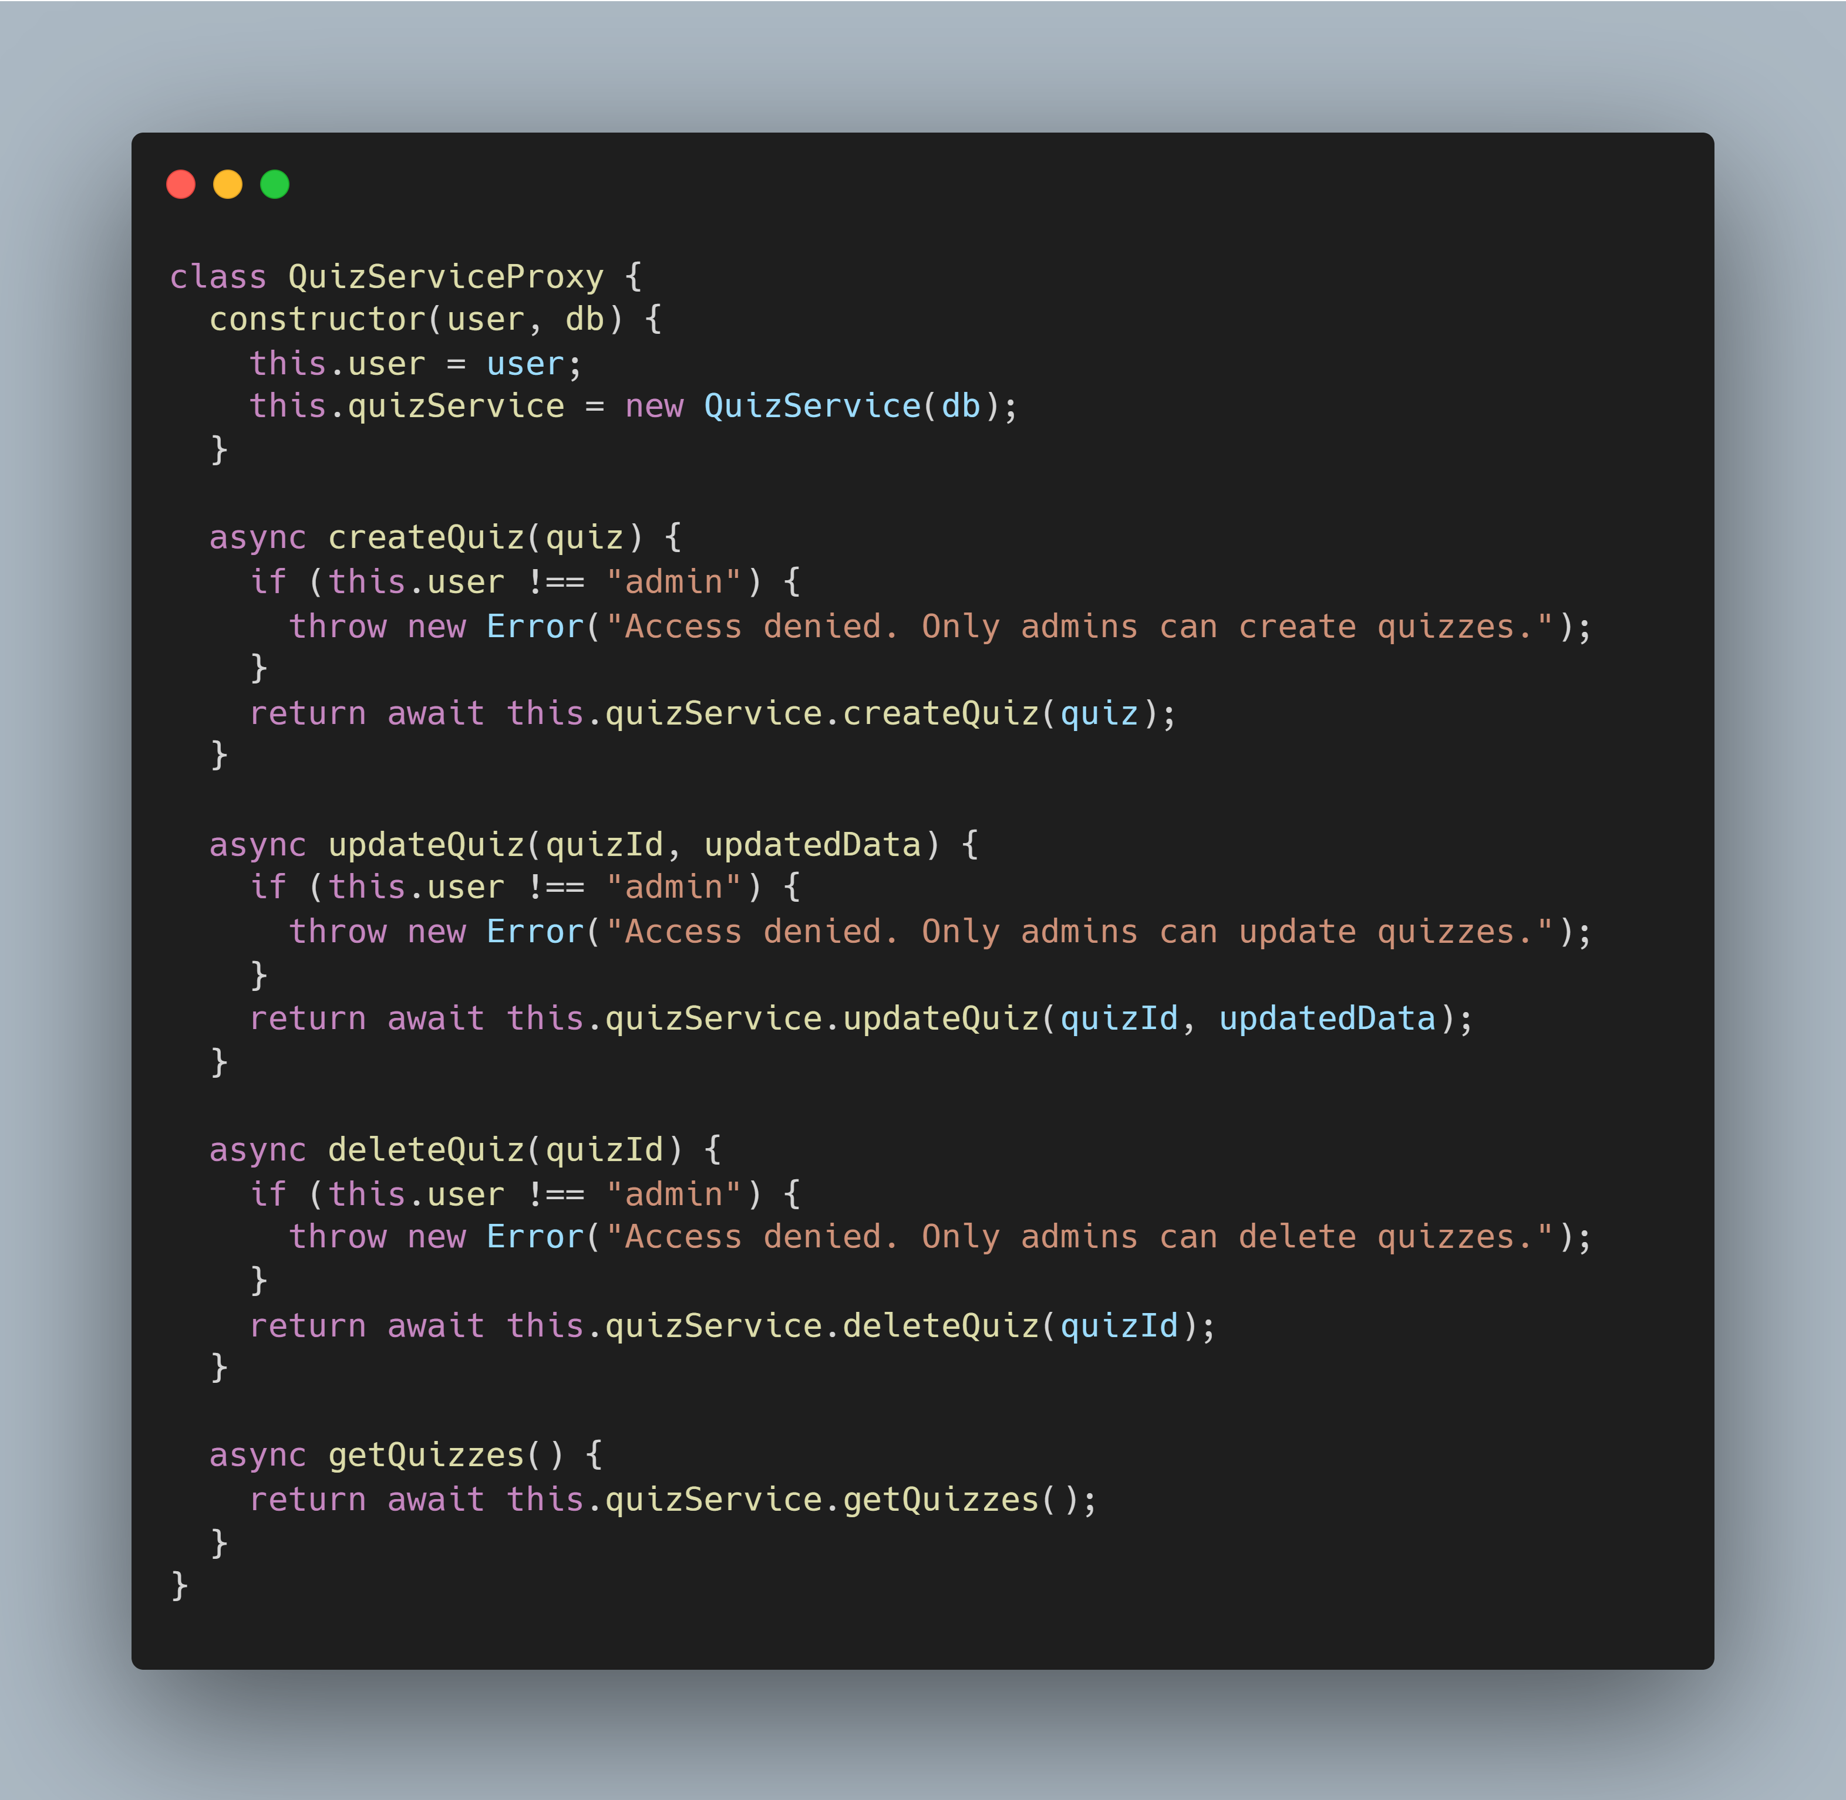
Proxy Design Pattern

Slide 26
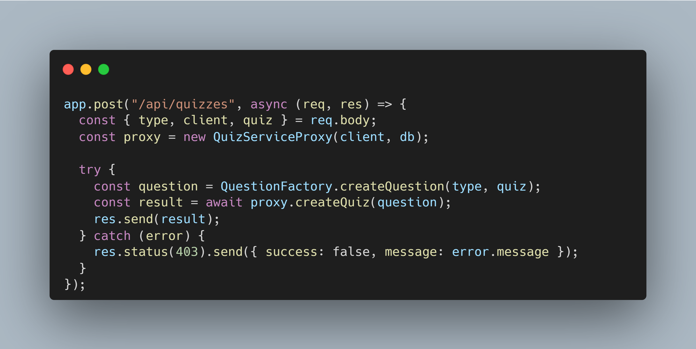
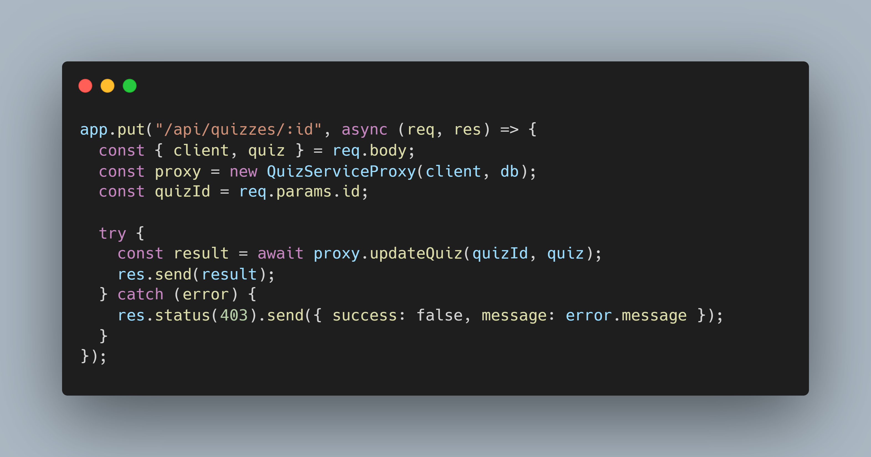
Proxy Design Pattern

Slide 27
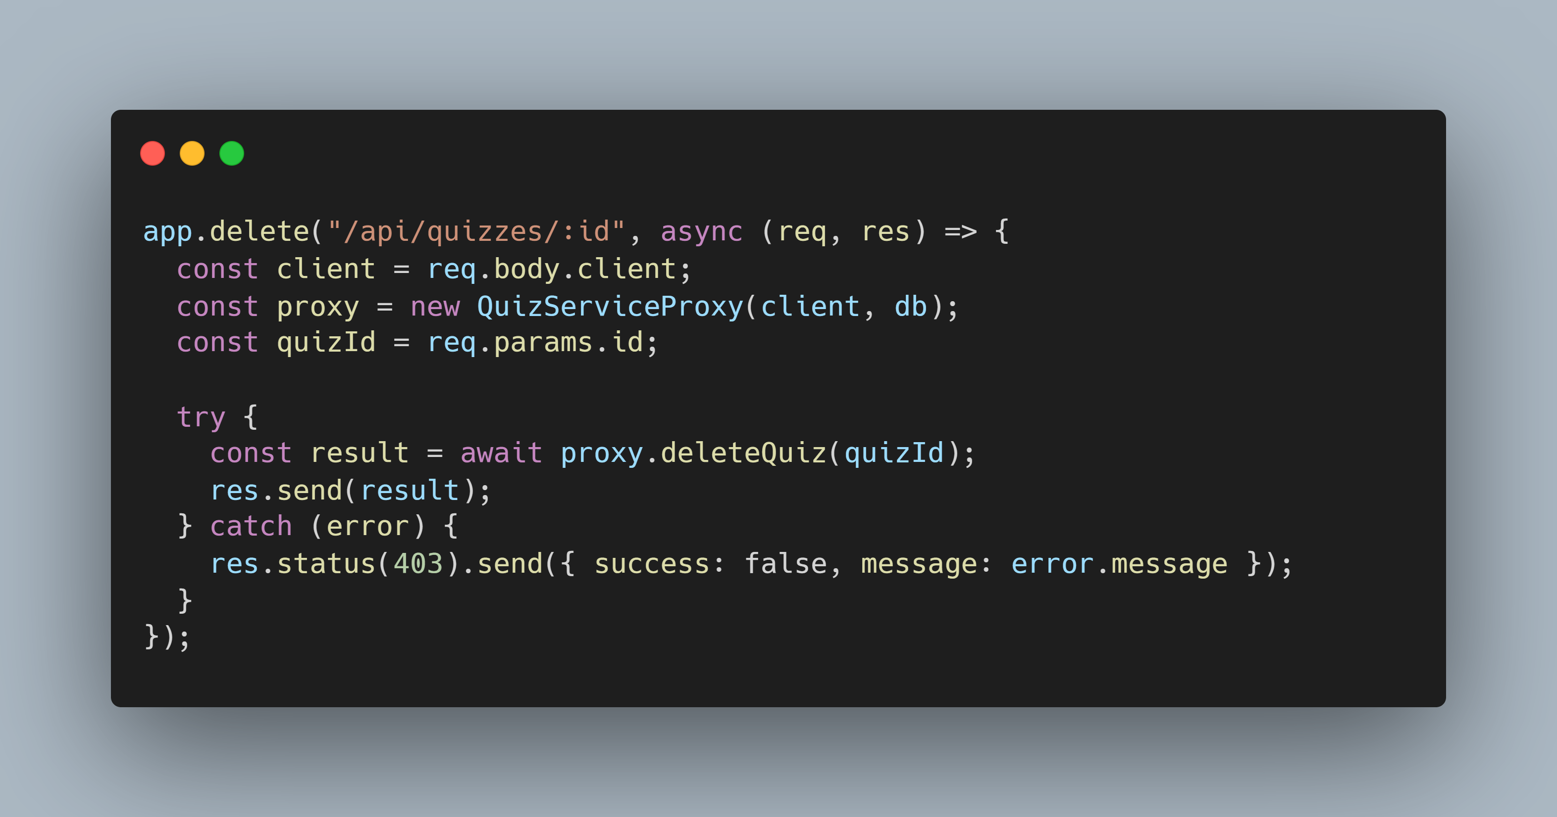
Proxy Design Pattern

Slide 28
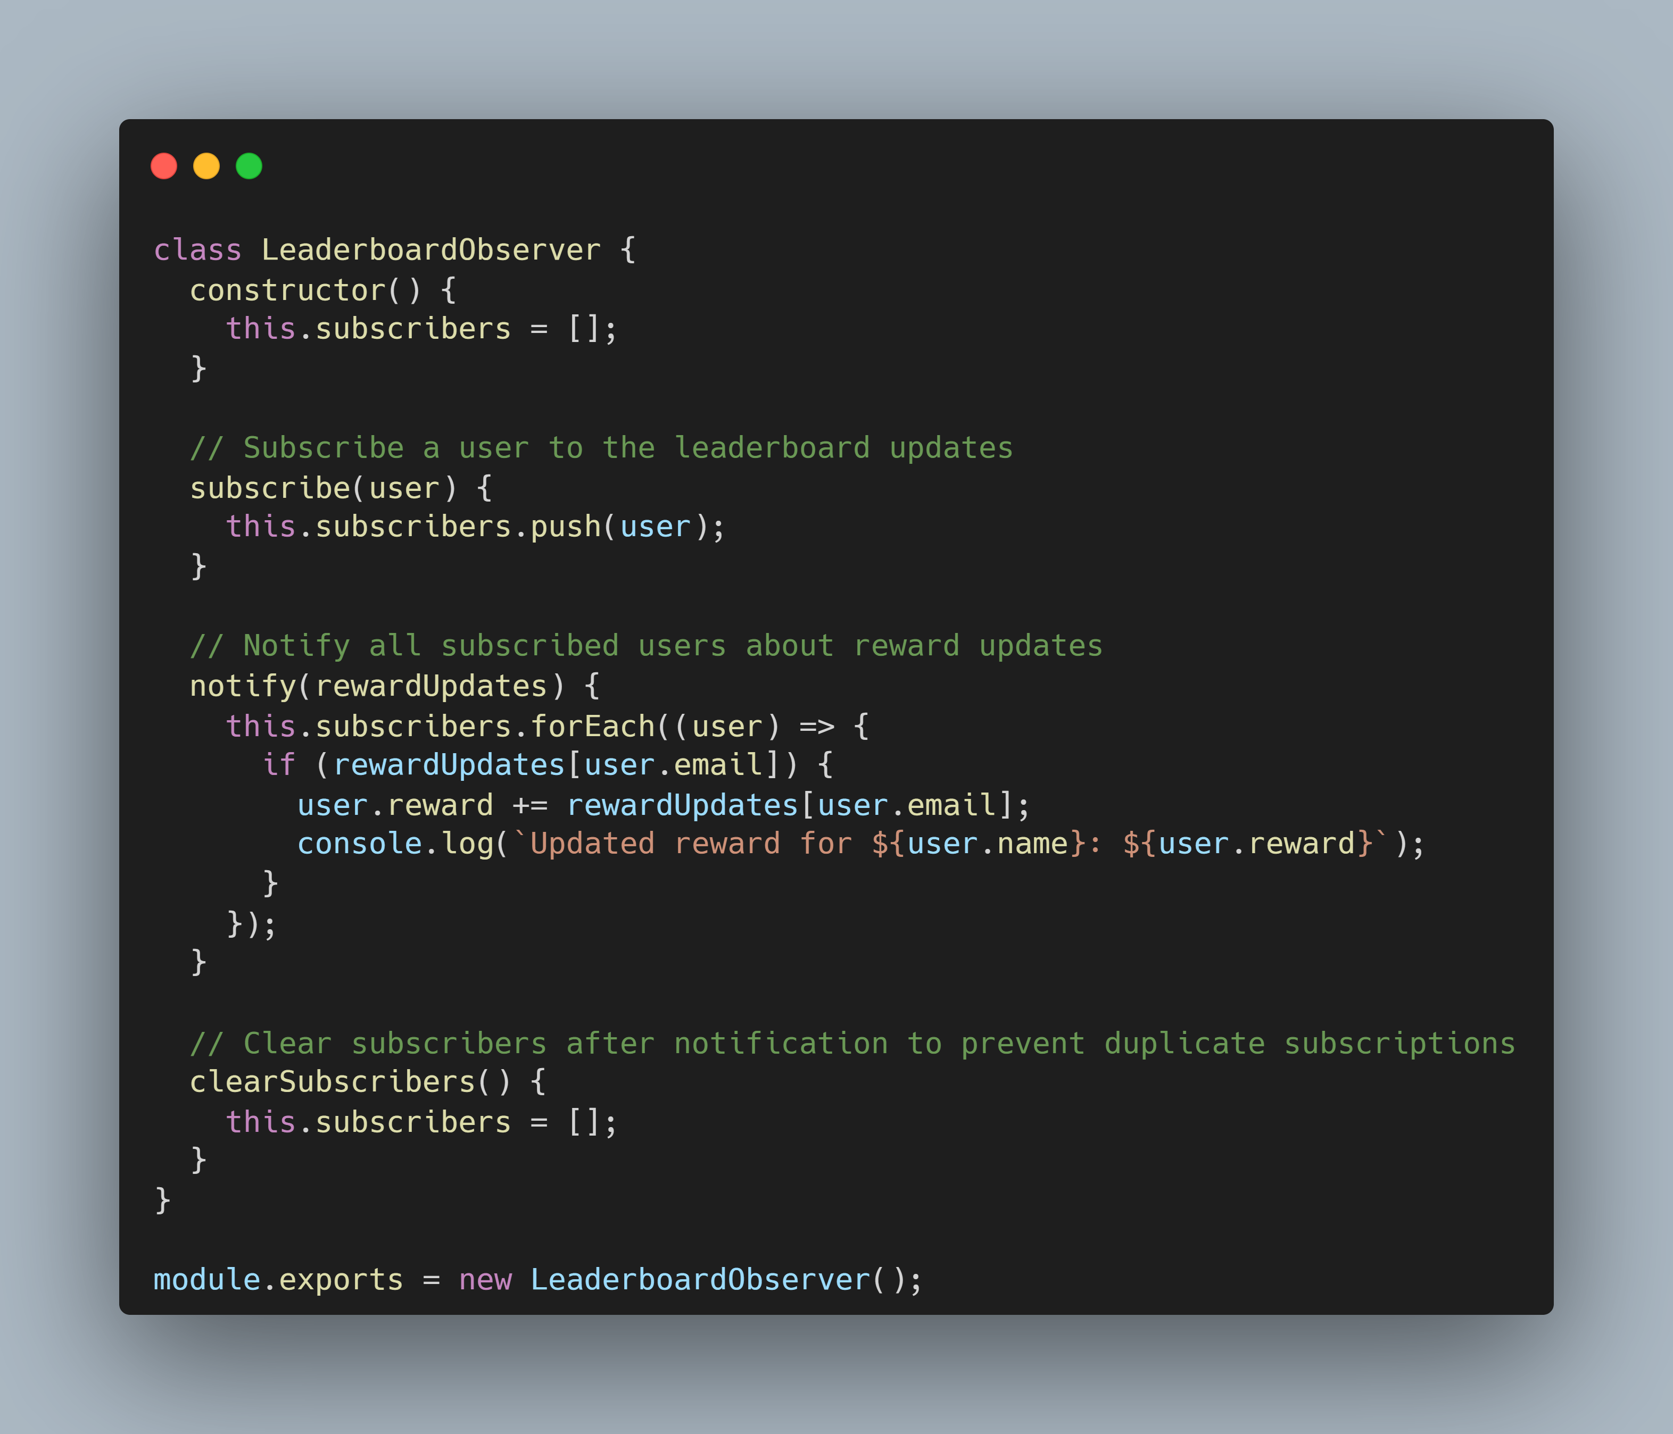
Observer Design Pattern

Slide 29
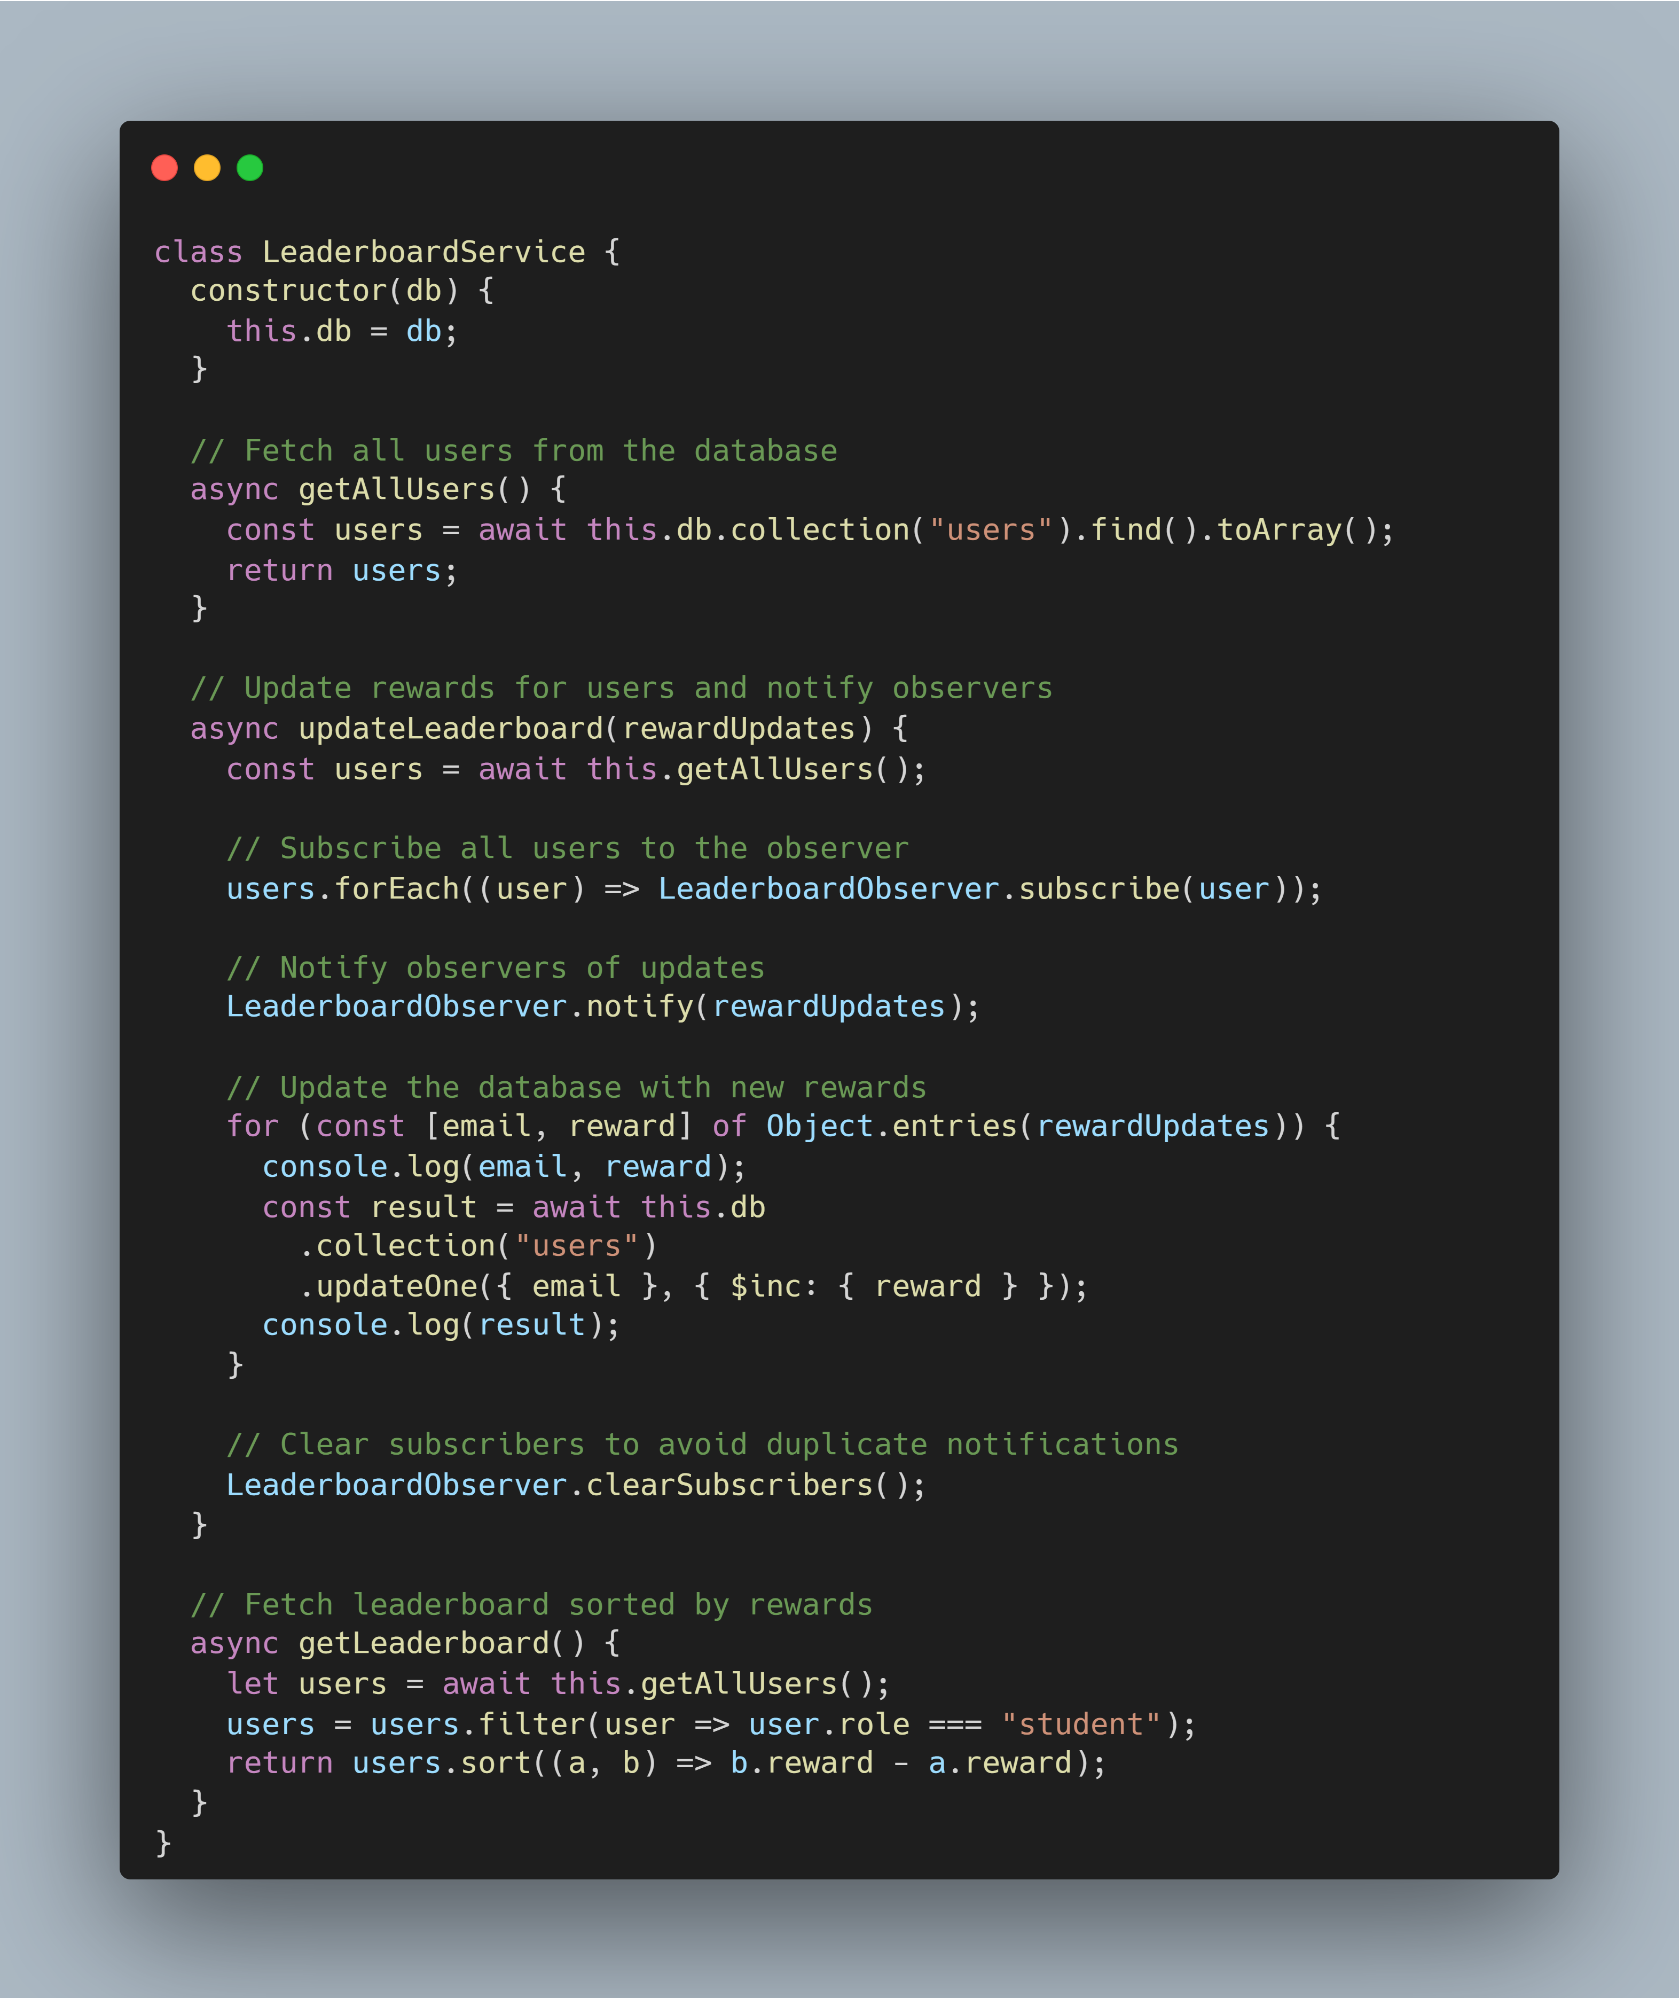
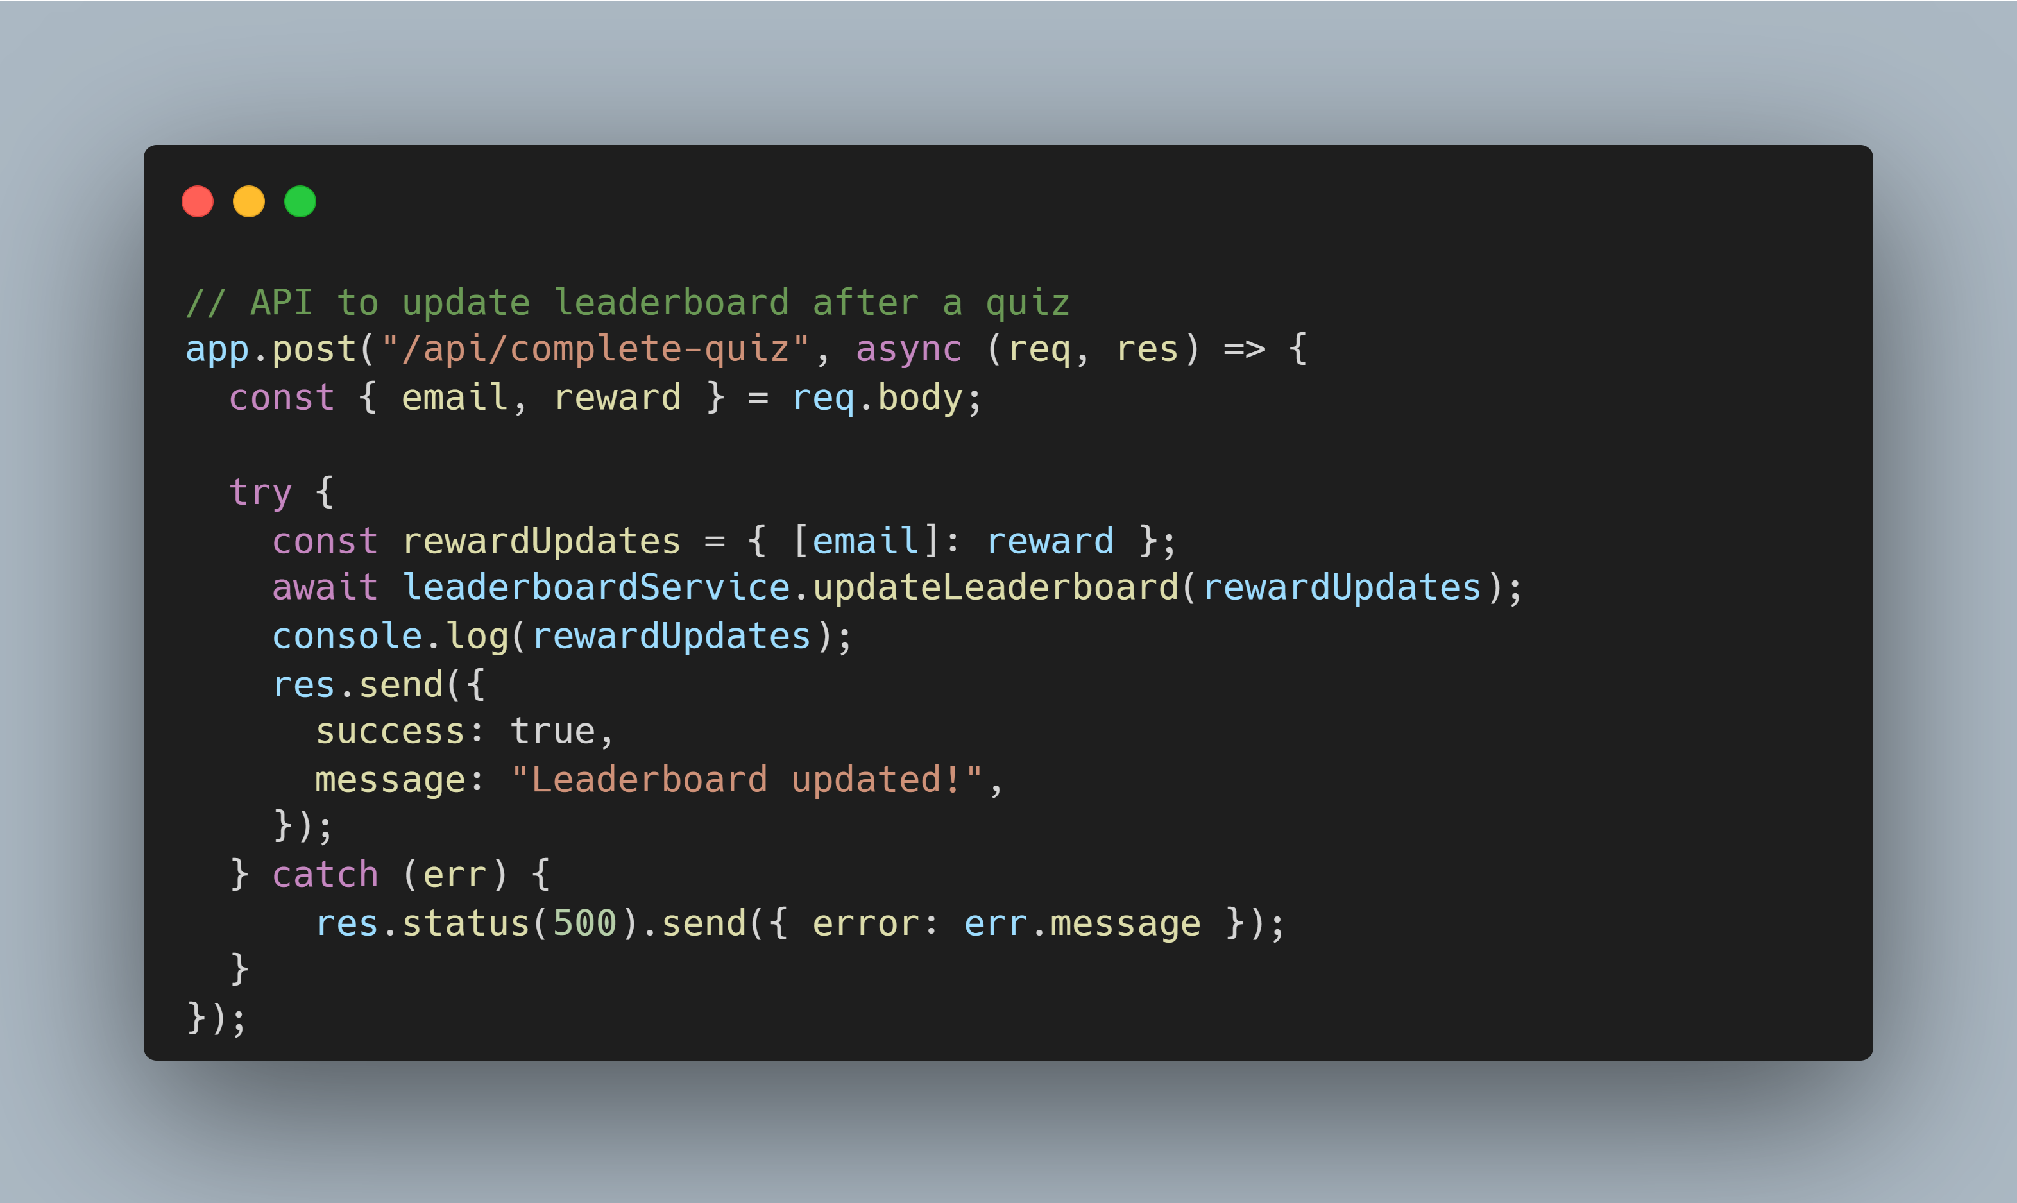
Observer Design Pattern

